Slide 1
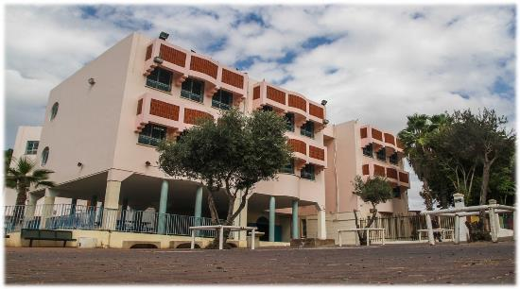
מערכת החינוך ביפו כעיר מעורבת The Jaffa educational system as a mixed city
מאת: עבד אלחלים סטל
מנהל שש שנתי
By: Abd el Halim Satel
The school principal

Slide 2
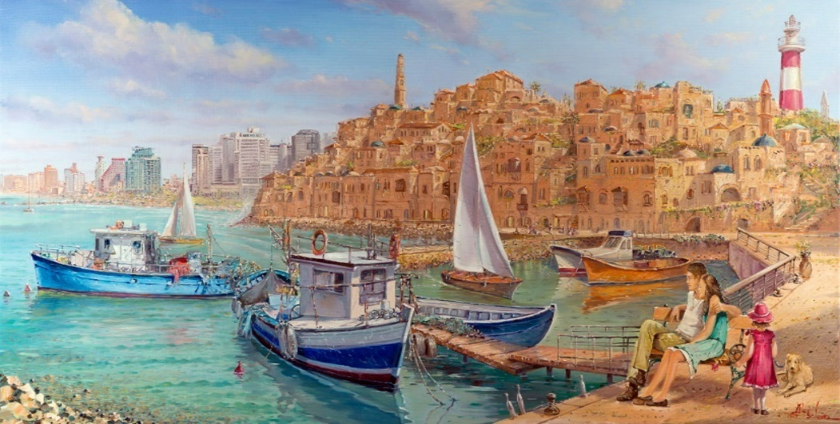
Mixed cities in Israel
Are cities in which a significant Arab minority (over 10%) lives alongside a Jewish majority. 2.216 million people in Israel (about a third of the country's population) live in mixed areas, of which 1.330 million are Jews (about 60%) and 885,000 Arabs (40%).

Slide 3
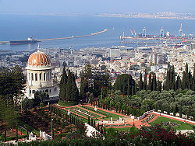
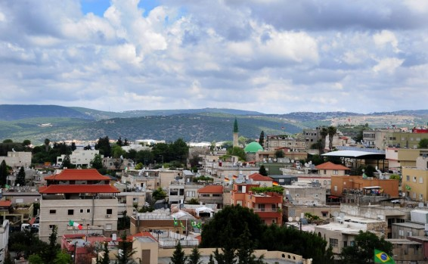
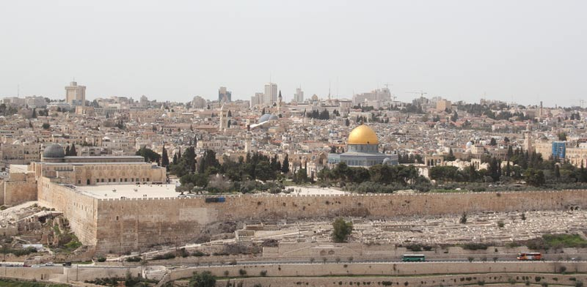
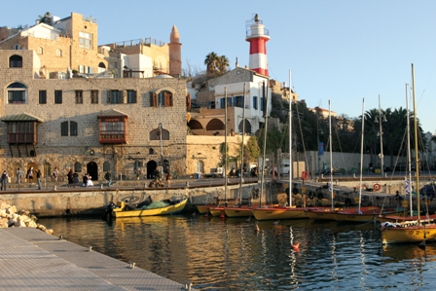
Mixed cities in Israel
Jerusalem: Approximately 64% of the city's residents are Jewish, and approximately 34% are Arabs
Tel Aviv-Yafo: Approximately 92% of the city's residents are Jews, about 4% are Arabs
Haifa: Approximately 82% of the city's residents are Jews, about 10% are Arabs
Acre: Approximately 67% of the city's residents are Jewish, and approximately 27% are Arabs
Ramle: Approximately 75% of the city's residents are Jewish, about 22% are Arabs
Lod: About three-quarters of the city's residents are Jews and about a quarter are Arabs
Maalot Tarshiha: Approximately 69% of the city's residents are Jewish, and 31% are Arabs
Upper Nazareth: Approximately 87% of the city's residents are Jewish, and approximately 13% are Arabs

Slide 4
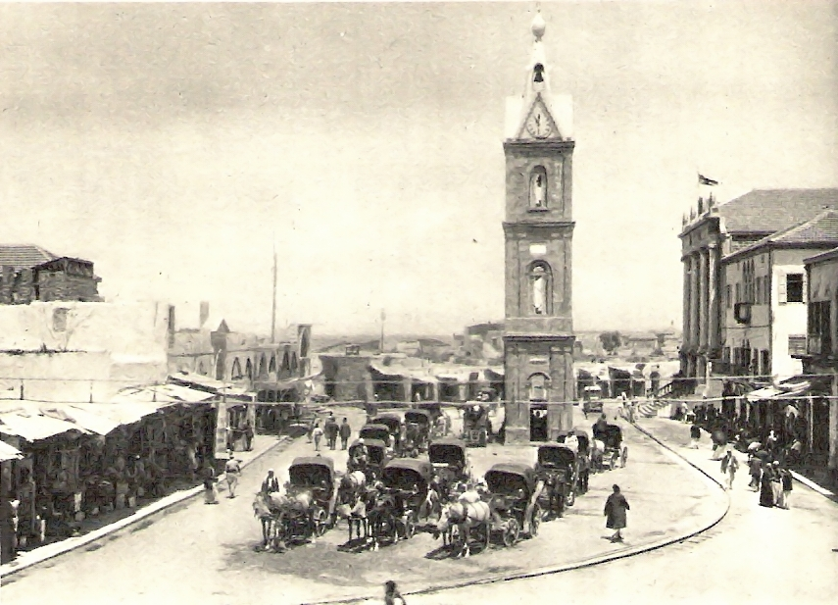
Jaffa as a mixed city
As a central port city, Jaffa was the gateway to the Jewish settlers and later the Zionists. Until the third Aliyah, Jaffa was the capital of the Zionist settlement.
With the establishment of the State of Israel, Jaffa lost its municipal status as an independent local authority.
After a short period of military government after 1948, it was annexed to Tel Aviv in 1950 and since then the Arab community has been a national minority in a Jewish city.
After 1948, there remained in the city a low-income Arab population of only 3900 residents out of a community of 70,000 before the outbreak of hostilities.
Arab Jaffa remained without an intellectual elite, middle class and social leadership. At the same time, Jaffa was populated by tens of thousands of Jews from the Balkans and North Africa.

Slide 5
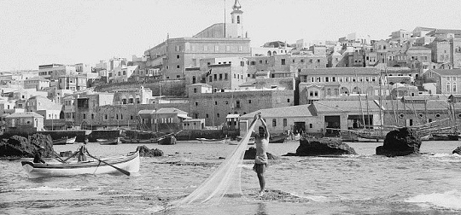
Over the years, those Jews who arrived in the city and were economically established left Jaffa, and Jaffa remained a weak and resource-poor Jewish and Arab population. Today, Jaffa has 50,000 residents, of whom 16,341 are Arabs. The Arab population of Jaffa is a young population (44%). Of the Arab residents of Yafo, 7146 are young people aged 0-19.

Slide 6
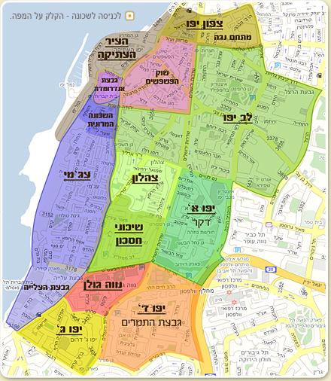
The Arabs of Jaffa are concentrated in five central neighborhoods
Yaffo D
Yaffo G
LiveYaffo
Jabalia
Ajami
The situation of the Arabs of Jaffa is also inferior to that of the Arabs in other places in Israel, both in terms of status and education and in terms of income.
Jaffa is different from the other old Arab cities in that it is cut off from other Arab population centers.
As of today, with the entry of a religious Jewish population and the entry of affluent Jewish residents into its neighborhoods, there has been a change in the fabric of life in the city.

Slide 7
The structure of the educational system in Jaffa
In Jaffa there are Jewish and Arab state educational systems, as well as Arab church and private educational institutions.
Jaffa residents can choose between public education - the Arab state system and, to a certain extent, the Jewish system, and the church and private educational system.
In Jaffa there are four Arab public elementary schools:
Ajyaal
Ahvaa
El Zahraa
Live Yaffo
Hassan Araffa
In addition to Jewish primary schools, the percentage of Arabs studying in them is particularly high, especially in the Hashmonean, Itamar, and Avigal schools.

Slide 8
Secondary education
Ironi Lamed Geemel opened recently
Ajyal
Ironi Yud Bet
Professional schools
Ironi Kaf Bet
Amaal One / Jewish School – where all students are Arabs
Private schools
Freres
French School
Orthodox
D habita
English School
Terasanta
At the same time, in the Jewish education Ironi z school

