Slide 1
Mentoring Ministry of Education Policy and Training at Beit Berl College Presented by: Dr. Ali Wathad and Mali Leibowitz Teaching Induction and Novice Teachers Advancement Unit

Slide 2
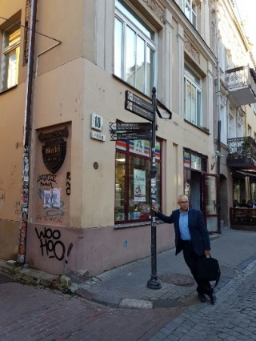
Personal Introduction – Mali Leibovitz
I am very pleased to be making this presentation to you today. I was born not far from here, in the great city of Vilnius, capital of Lithuania
I serve at present as coordinator of internship in teaching, engaged in training and support of interns and mentors throughout their professional development. I spearhead the development of tools for assessing kindergarten teachers, as well as models for novice kindergartens teachers absorption in the community.
Notes:
spearhead the subject of Mentoring of teachers in israel & development of models for novice kindergartens teachers
I

Slide 3
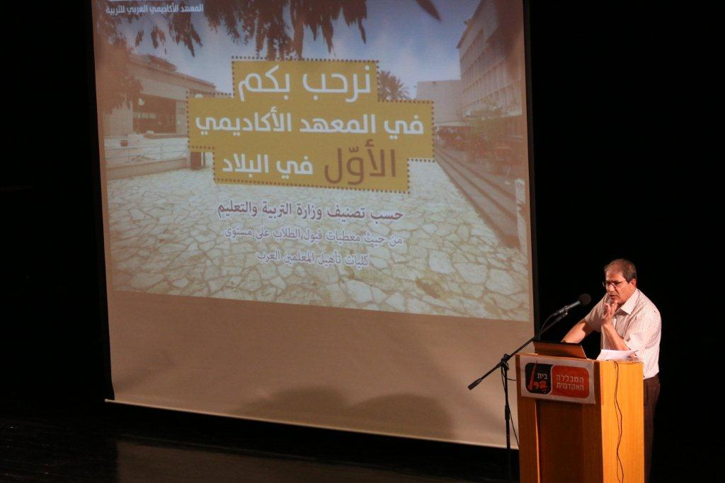
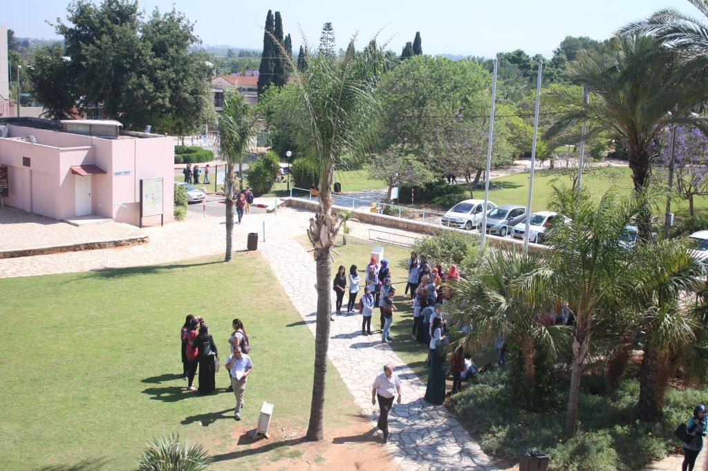
Personal Introduction – Dr. Ali Wathad
I am honoured to be a participant in this distinguished symposium and to be given the opportunity to deliver this presentation
I am Head of the Arab Academic Institute of Education, and a member of the Internship and Induction Department for Arab Teachers of the Ministry of Education

Slide 4
Mentoring in Israel
Our presentation centers on Israel's Ministry of Education policy, which refers to mentoring as the most important part of the internship system. The system includes 4 key components:
Work in the educational system
Support of the intern
Workshop at College/University
Assesment.
The focal point in the system is mentoring.

Slide 5
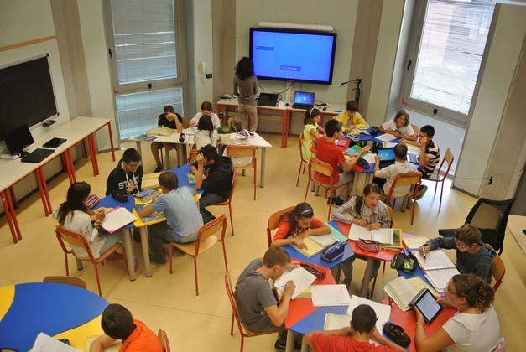
Internship – an Obligation and a Privilege
As of 2000, every school / kindergarten teacher who completes teacher training is obliged to undergo an internship year
Those who complete the year successfully are awarded a teacher's licence
Data at test to a significant decline in the dropout rate since the internship program was instituted

Slide 6
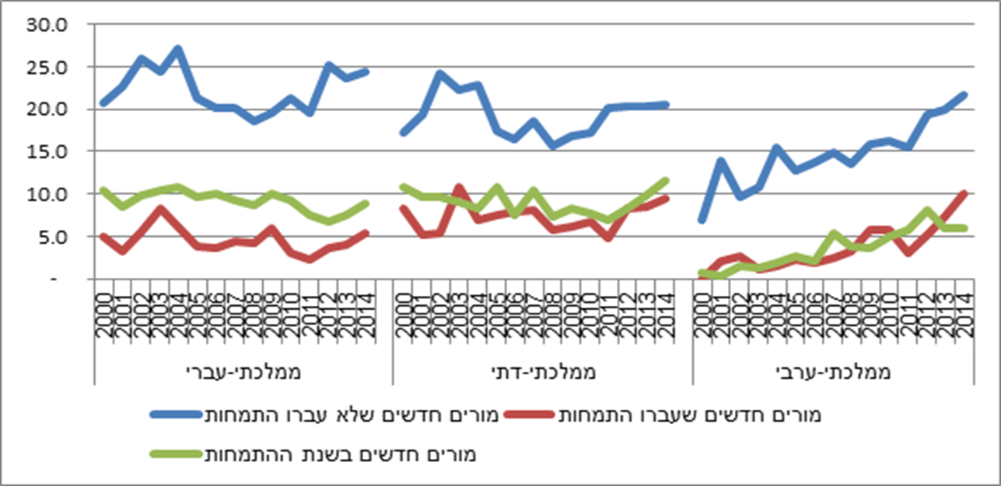
Dropout Rate During the Year Following Internship, 2000-2014
subtitle
Secular state schools, Religious state schools, Arab state schools
Novice teachers who underwent internship, Novice teachers who did not undergo internship, Novice teachers during their internship year

Slide 7
Role Played by the Mentor in the Intern's Success
A handbook for policymakers, titled "Developing Coherent and System-wide Induction Programmers for Beginning Teachers", published by the Committee on Culture and Education of the European Union (European Commission Staff Working Document, 2010) refers to mentoring as one of the most important factors in meeting the needs of interns from the personal, social and professional viewpoints.
Mentoring is the key component in internship in the teaching profession. The mentor is the principal agent responsible for assisting the intern in developing his personal and professional identity during the stage of absorption into the educational system (Shaz-Openheimer, Mendel & Zilbershtrom, 2014). Mentoring has a significant role to play in supporting novice teachers and preventing dropout during the initial years (Marable & Raimondi, 2007; Goldrick, Osta, Barlin & Burn, 2012).

Slide 8
The Personal Touch in Helping the Beginner

Slide 9
The Mentor as Motivator and Supporter in All Walks of Life
The Intern – a film about a senior citizen assisting a woman in managing an online sales business https://www.sratim.co.il/video.php?id=9473
An – a film about a woman specializing in pancakes who succeeds in salvaging a failing enterprise … https://www.youtube.com/watch?v=eIqVs0P9FjA
Fireflies: River of Light – a film about a teacher coping without guide or mentor, and supporting a moral, scientific and social process that could have been different with a needs-based approach https://www.youtube.com/watch?v=eaDci5MwLRk&t=380s

Slide 10
Ministry of Education Policy Regarding the Mentor's Responsibility
A document containing updated information, was published a month ago for the benefit of all concerned parties in Israel's educational system.
The document is the result of negotiations with the Primary and Secondary Teachers Association and it is hoped that in the coming summer it will apply to high school teachers as well.
Reference is made in the document to the responsibility borne by schools and the inspectorate for the appointment, training and remuneration of mentors, who according to plan are to be paid a sum equivalent to a percentage of their salary.
To date payment for their services has been transferred through training institutions.
The origin of the word salary is "salt",
a term dating back to the Middle Ages,
when soldiers were paid in salt
for service to their country.

Slide 11
Definition of the Role of Mentor
The mentor coaches the intern during his internship year and provides him with support in the following fields:
Professional: familiarizing the intern with the syllabuses, assisting him in student assessment, class management, cultivation of professional thought processes, and observation and assessment of intern performance
Emotional: nurturing a professional self-image, assisting in coping with feelings of isolation or frustration, and in developing a sense of trust between the intern and the teaching staff, the children and the parents.
System-wide: familiarizing the intern with the system's procedures, the intern's rights and obligations, and ensuring his integration into the teaching staff.
The mentor assists the intern / novice teacher in his absorption into the educational institution by cultivating the abilities that are essential to his work.
He is the person to whom the intern / novice teacher turns for urgent consultations, support and troubleshooting when difficulties arise with the students, the parents and the staff.
He is party to the process of intern assessment in both the formative and summative assessment stages ahead of receiving his teacher's licence.

Slide 12
The Mentor's Modus Operandi
Holding weekly hour-long personal meetings with the intern concerning his teaching and the educational issues he encounters in the course of his work
Observing the intern's lessons, holding feedback sessions after each observation and recording the observations – collecting evidence to support his assessment
Ensuring that the intern observes the mentor's lessons
Establishing contact with the principal / inspector, officers and general staff in order to develop an optimal culture for absorbing interns
Notes:
הכל באופן גלוי כחלק מצמיחה מקצועית של המתמחה

Slide 13
Conditions for Appointment to the Position of Mentor
A teacher who is part of the staff in the school where the intern is employed (school principals and inspectors cannot serve as mentors)
A person holding a teacher's licence
A person with at least 4 years experience in teaching
Preferably a person with experience in teaching at least one subject taught by the intern and working with the same age group as the intern
A graduate of a mentoring course in a teacher training institution, and a participant in seminars on the subject of professional development and intern support and guidance held in a college / university

Slide 14
Training of Mentors Throughout Their Professional Development Stages
Category 2-6 teachers with 4-12 years experience – 60 hours of training
Category 7-8 teachers with 13-22 years experience – 120 hours of training
Supervision for graduates of the training program
Training is in line with the policy and pedagogical framework of the educational system, with the emphasis on team work.
It is hoped that results will be better than those achieved by the characters in the attached video clip. https://www.youtube.com/watch?v=BTpGJfh8xkI

Slide 15
Training Programs
The training programs include the following subjects:
Understanding of the role of mentor
Guidance and consultation
Support and assessment, and collection of supporting evidence
The world of the novice teacher
School and community culture
Guidance in handling parents and children with special needs

Slide 16
Survey of Mentoring Needs in 2016
As of 2016, 29.7% of the mentors in Beit Berl College had undergone training for their position
70.3% are engaged in mentoring without training

Slide 17
Strengthening the Bond with Mentors as a Condition for Optimal Absorption and Support
The fact that only some 30% of mentors are trained for their position necessitates the formulation of creative solutions such as:
Distribution of bulletins to mentors containing relevant information on every internship stage
Individual responses to difficulties and questions in connection with mentoring
Direct dialogue with school principals and kindergarten inspectors
Setting up a Facebook group for mentors providing online assistance
Group sessions and seminars aimed at achieving greater professionalism

Slide 18
Positioning and Training
A breakthrough has been achieved in the way of collaboration with teachers' associations, with hope for positioning the role of mentors and ensuring training as part of the requirement for the role.

Slide 19
Thank you

