Slide 1
Proteach at Talpiot College
Dr. Avigaiel Tzabary & Mrs. Idit Pasternak

Slide 2
Contents
Talpiot College – a visiting card
The Unit for Induction into Teaching at Talpiot College
Activities that were taken towards MIT
What’s next?

Slide 3
Talpiot College – Vision & Goals
Talpiot College was established as a national religious college for female students.
The main vision of management and academic-team is: teacher training is a national challenge.
The ideology of TC is that teachers’ training form the human future capital of the State of Israel.

Slide 4
Therefore TC takes the responsibility of developing an educational leadership whose roots are in the past and whose vision is directed toward the future, updating itself according to progress and the spirit of the times.
Most of the students are religious women.
In accordance with the pluralistic spirit of management and lecturers there are also male students and non-religious students at the college.

Slide 5
THE STRUCTURE OF THE UNIT
INDUCTION INTO TEACHING AT TALPIOT COLLEGE
Head of the unit
Head of the research unit
Teaching & guidance
Academic activity
Induction + MIT
Teachers 1st year
Mentors
Contact with the field
Research
Development
Course moderators
Course moderators
Workshop moderators
Notes:
This activities are taking place in Collaboration with the research unit idit is responsible for

Slide 6
ACTIVITIES TOOK PLACE
TOWARDS MIT
1. Meetings to Present the Project (11-12/2016)
With Policy Makers
Local authority:
Petach - Tikva Education Department
Supervision:
Supervisor for State Religious Education in the Tel - Aviv district
School supervisor

Slide 7
With Schools
Meetings with school principals –
The meetings took place individually with each principal separately.
Notes:
during the months

Slide 8
2. A Co-Meeting (January, 2017):
Conducted with the schools’ supervisors, the schools’ principals, and the leaders of MIT at the college:
An overview about the MIT was conducted
definition and aims were discussed

Slide 9
The supervisors and principals expressed their agreement and motivation for the success of the project.
The supervisors declared that assigning teachers at 2018 will be coordinated with the college.
Tasks were distributed to the participants before the next meeting (like: mapping the school’s needs for the next school year; defing the school’s vision).

Slide 10
Meeting with the school principals (28.2.2017)
Absorption coordinators have been appointed in each school.
A coordination of requirements has been conducted for teacher placements in the next academic year.
A syllabus has been jointly built for an internship workshop.
The counselor’s role has been defined, and they will play an active role in the process.

Slide 11
A meeting has been scheduled for the end of April.
The principals have been asked to consider the further education courses they would be interested in having in the next academic year, which the college will coordinate.

Slide 12
PLANNED ACTIVITIES
(MARCH - JUNE, 2017)
Course - Building syllabus for an academic course according the project ideas for Students in the training process
The course will deal with organizational sociology, with the school as a system, and with the absorption of new teachers and MIT project.
Thinking about feedback and evaluation norms.

Slide 13
Selecting students to specialize in the MIT in the next year.
Selecting participants to the workshop from:
the schools
the supervisory
the Authority
Website for work and communication among all the partners.

Slide 14
Creating Collaboration with “field academy” according to the needs of the system and the specializing students;
Proposals for accompanying research studies;
Recommendations for initiatives by the new teachers in the schools and in the community;

Slide 15
ADVERTISING THE MIT IDEA
1. In The College
The project was presented at:
A meeting in the opening of the academic year at the college.
A meeting of the teaching committee at the end of the first semester.
2. At conferences
The project was presented At the Tel Aviv District’s supervisors’ conference that was held in the college, in the framework of new cooperative among the supervisors, the academic-team, and the schools.

Slide 16
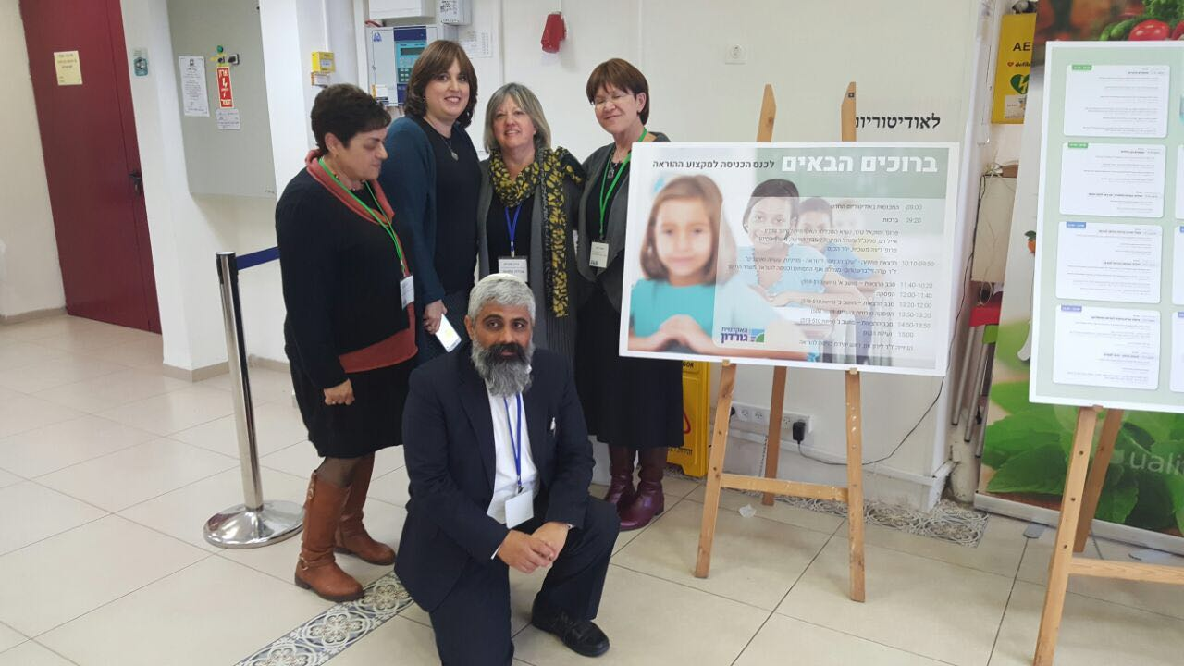
In conference at Gordon College, Haifa, Israel

