Slide 1
Mekif Vav
Comprehensive School
Beer Sheva
Growth Resources
Kaye Experimental Induction Unit
In collaboration with the Division for R&D, Experimental Schools and Initiatives
Ministry of Education
Growth Resources – PROTEACH
2016/2017
Norit Avasker

Slide 3
The Context
Growth Resources – Kaye Induction Unit
Accompanies novice teachers during their initial years of entering the teaching profession (the induction period):
Internship year.
Beginning teachers (first and second year in teaching).
Also – mentoring development program.
Kaye Induction Unit has been recognized as an experimental unit by the Division for R&D, Experimental Schools and Initiatives, Israel Ministry of Education.

Slide 4
The leading theoretical framework in the Growth Resources Unit is Self-Determination Theory (SDT; Deci & Ryan, 2000) .
Additional theories and methods:
Positive psychology
Identity construction and exploration processes
Narrative approach
Action research

Slide 5
Erasmus+ Project – 2016-2017
PROTEACH – Promoting Teachers’ Success in Their Induction Period
Mekif Vav-Kohl
Beer Sheva
Mekif Vav Comprehensive High School, Beer Sheva Incubator

Slide 6
The Leadership Team 2017
Mekif Vav
Mati Mindlin, Principal
Dorit Schwartzberg, School Counsellor
Keren Turner, Incubator Coordinator
David Greenberg, Pedagogical Coordinator
Kaye College
Dr. Haya Kaplan, Head of the Unit
Rachel Tzafrir, Incubator Coordinator
Dafna Govrin, MIT Group moderator
Dr. Shulamit Fisher, Evaluation Coordinator
Vardit Israel, Mentoring Coordinator
Dr. Mark Applebaum, Head of the Research Authority
Erasmus+ Project
PROTEACH – Promoting Teachers’ Success in Their Induction Period

Slide 7
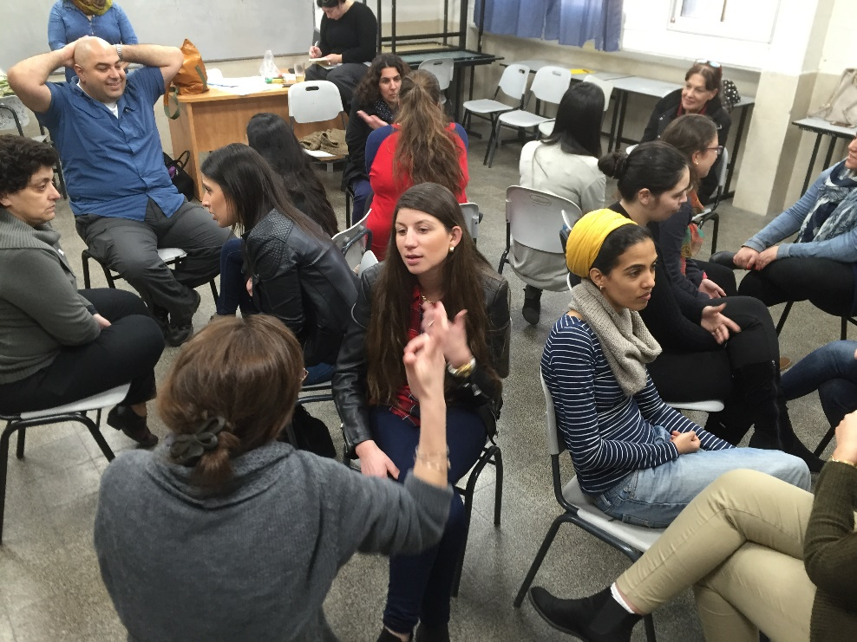
The Story of the Partnership 2014-2017
Incubator in Mekif Vav
in partnership with
Kaye College

Slide 8
The Story of the Partnership, 2014-2017
An incubator in Mekif Vav in partnership with Kaye College
In the first two years, 47 teachers from the school participated in the incubator.
A steering committee was established for the purpose of joint thinking and learning.
Three circles of learning were built:
Two courses for teacher interns and beginning teachers.
Two training courses for mentors, Grades 2-6.
Introductory encounter with the incubator and enrichment for the entire teaching staff at the school.
Meetings of the extended management staff with the teachers and their mentors and the incubator’s coordinator from Kaye College.
In 2016 we focused on promoting proactiveness and initiative – learning innovative pedagogies, experiential learning, and ICT.
Peak meeting – 10 teacher interns and beginning teachers led activities for the entire teaching staff – 120 participants.

Slide 9
Achievements – 2014-2016
Evaluation Report Findings
Sense of relatedness, competence, and autonomy increased following the activities in the plenum.
A beginning teacher in the incubator:
“The encounter raised awareness to the beginning teacher and reminded all the veteran teachers that attention must be paid to beginning teachers, to try and help them, and especially to always support them”.
The beginning teachers built a school absorption website, which constitutes an alternative for the absorption file and enables regular updates. Link to the website: http://merava8af.wix.com/makifvav
The level of awareness to the absorption processes, alongside abilities for empathy, attentiveness, and sensitivity toward the other, increased among the veteran teaching staff.

Slide 10
Erasmus+ Project – 2016-2017
PROTEACH – Promoting teachers' success in their induction period
Preparation / Meetings with policymakers
Meeting with the inspector of secondary schools in Beer Sheva to select the school and coordinate positions.
Meeting with the inspector on professional development in the Southern District.
Presenting the Induction Unit and the Erasmus+ Project to the District Director and leading inspectors, our partners in locality and school incubators.
Creating a support system, local authority + Ministry of Education, as part of a municipal incubator for novice teachers in Beer Sheva. Thus, the school incubator is housed in the municipal incubator.

Slide 11
The Incubator community in 2017
The community of the incubator includes 13 teacher interns and 4 beginning teachers, who are joined by 17 teacher-mentors, teachers from the school, and the college staff.
The incubator in Mekif Vav is part of a locality-based incubator in Beer Sheva.
Partners in the program also include officeholders at policymaking level in the Ministry of Education and local authority.
Together the group forms a unique team, called MIT, that leads to the optimal integration of beginning teachers in the school and the education system.
Erasmus+ Project
PROTEACH – Promoting Teachers’ Success in Their Induction Period

Slide 12
The MIT Group
Teacher's Voice
Supporting relatedness, competence, and autonomy
Self-determination
Autonomous Motivation
Exploration
Proactiveness
Local Authority
Ministry of Education
Community
Veteran Teachers
Senior Management Staff
Mentors
The School Counsellor
and Coordinator
The College Facilitator
and Coordinator
Interns and
Beginning Teachers

Slide 13
MIT Meetings
Meetings of the school’s leadership team with the principal, systemic MIT team.
Meetings with the principal – work contract, setting the project’s structure, policy, annual work program adapted to the school program, regular feedback meetings.
Meetings with the absorption/incubator coordinator at the school – to organise the group of teacher interns and beginning teachers, identifying teachers and their suitability for the program, regular feedback.
Meetings with the school counsellor – identifying teacher-mentors and their suitability for the program, ways of pairing mentors and beginning teachers/teacher interns, building modes of action.
Erasmus+ Project
PROTEACH – Promoting Teachers’ Success in Their Induction Period

Slide 14
Organizational Aspects
Role Definitions in the MIT
School Management
Regular contact on meeting content and empowerment processes of the interns and beginning teachers at the school
The School Coordinator and Facilitator
Planning the meetings and content with the college staff, co- facilitator
Mentors
Teacher-mentor relationship, personal and professional mentoring, personal evaluation processes, accompanying initiatives
School counsellor
Training the mentors on mentoring and evaluation processes, involvement in planning the meetings and content
The College Coordinator and the Group Facilitator
Planning the workshops and process in constant collaboration with the school staff
Erasmus+ Project
PROTEACH – Promoting Teachers’ Success in Their Induction Period

Slide 15
Principles of the Syllabus
Flexibility, a dynamic and evolving syllabus
Meeting date: 6.12.2017
Participants: Teacher interns and beginning teachers.
Nature of the meeting: Exploration-promoting dialogue, acquaintance activity, led by a teacher intern – from idea to initiative.
Led by: Incubator moderator, teacher interns, and beginning teachers.
Subjects and content:
My encounter with myself as a student/learner/teacher and the discourse between them.
Meeting “over a cup of coffee”: promoting an informal meeting initiative to foster a sense of relatedness to the group.
How was room given to the beginning teachers’ voice? Activity initiated and led by the interns.

Slide 16
Values Underlying Professional Identity
Meeting date: 17.1.2017
Participants: Teacher interns and beginning teachers, incubator moderator and coordinator.
Nature of the meeting: Planned workshop based on an open dialogue.
Led by: Incubator moderator tor and coordinator – joint facilitation of an open dialogue with all the participants.
Subjects and content:
Workshop – Developing a personal and professional identity by means of a “crystal ball”
Identifying values at the basis of constructing the self.
Joint construction of a workshop for the extended management staff – “Constructing the Professional Self”, employing a “Shvsevet” method and questions about personal and professional values that are expressed in the process of teaching.
Allocating facilitation roles to the beginning teachers and teacher interns.
How was room given to the beginning teachers’ voice?
After the workshop a discussion was held with the teacher interns with the aim of building an activity under their leadership for the extended management staff.
The interns asked questions, expressed their personal opinions, and proposed an alternative activity, which was of course accepted.
The teacher interns and beginning teachers led the workshop in the meeting with the extended management staff.

Slide 17
Introductory Meeting Led by the Interns and Novice Teachers
Dialogue on Professional Identity and Personal Values
Meeting date: 24.1.2017
Participants: 17 interns and novice teachers, 17 mentors, school principal, general managerial staff, officers, and college staff.
Invited but unable to attend school inspector, acting officer in charge of education in Beer .Sheva Municipality
Nature of the meeting: Planned workshop based on an open dialogue.
Led by: 17 interns and novice teachers.
Subjects and content:
The present meeting was planned as a festive one with the entire MIT group in order to mark the official launching of the project. Identifying values at the basis of constructing the self.
"The Crystal Ball – My Professional Identity, My Core Values" (see syllabus). The aim of the preliminary meeting was to allow the participants to experience a process that they would themselves moderate.
Subjects for conversation selected by the group:
What did I bring with me that helped me be the teacher I am?
One value that guides me in wearing my professional hat.
A value that has become meaningful for me over the years, a value that has changed. What caused this?

Slide 18
Activity steps:
Part One: Dialogue according to the Shavshevet method.
Division of the group into two circles, an inner one and an outer one: the inner circle is fixed and sitting in it are the interns and novice teachers; the outer circle includes the veteran teachers (school principal, school counsellor, managerial staff, mentors, officers). Each of the participants in the outer circle moves one chair to the right after each dialogue.
The participants are seated facing each other. The time allotted to a dialogue in pairs is 5 minutes, each of the participants receiving 2.5 minutes. Every 5 minutes the topic is changed.
How was room given to the beginning teachers’ voice?
The interns and novice teachers chose the questions and the topics, and volunteered to moderate the various steps.

Slide 19
SDT-based Principles in the MIT Group
Relatedness Support (in the group and with reference to the school staff)
Constructing the group: acquaintance, initial contract, clarifying expectations, formulating rules of safe discourse, non-judgment.
The group as a safe place for questions, doubts, conflicts, disagreements, legitimacy for expressing difficulties.
Reflective dialogue, emotional language, sharing experiences and feelings.
Experiences that strengthen familiarity and deepen connections within the group and with the school staff.
Creating a close-knit group with personal relationships (in the group and in their everyday work).
Familiarity with the organisational system in conjunction with leading figures from the school – management staff, principal, counsellor, officeholders – whom the participants wish to meet with.
Principal – personal contact, conversations, and ongoing support.
Absorption coordinator – personal contact, approached according to need, ongoing support.

Slide 20
SDT-based Principles in the MIT Group
Autonomy Support
According a central place to the teachers’ voice and needs. The teachers’ voice is at the centre of the meeting.
Enabling free expression of opinions.
The meetings enable discussion of authentic and relevant cases the teachers raise, content associated with the school and teaching.
The meetings strengthen explorative processes: clarifying issues associated with professional identity, what are my values? What does being a teacher mean to me? What are the conflicts I am contending with? Disparity between reality and ideal, dreams for the future, and so forth (Kaplan, 2015).
Involvement in choosing and making decisions concerning the group.
Some of the meetings are planned by the participants (self introduction, initiatives for the benefit of the school, informal encounter).
Autonomy-supportive evaluation processes (towards receiving a license, tenure) – dialogic evaluation in conjunction with the mentors and management representatives.
Absorption coordinator, counsellor, principal – channelling the teachers’ abilities for the benefit of the school’s needs, and enabling them to find their unique place in the school.

Slide 21
Supporting Basic Psychological Needs – The Teachers’ Voice
From Idea to Initiative – Autonomy Support
Emphasis is placed on the personal resources of the teacher interns and beginning teachers (fields of interest, abilities, talents).
Encouraging proactiveness and initiative – building initiatives in various fields of interest chosen by the teacher interns and beginning teachers and promoting them in the school, in conjunction with the mentors and officeholders in the school.
Some of the initiatives have already been chosen in a dialogue with the school staff and with its encouragement with the aim of promoting projects that are relevant to the school.
The initiatives will be presented in a meeting of the entire teaching staff and representatives from the Ministry of Education and local authority – at the end of the year as part of the school workshop.

Slide 22
Competence Support
Familiarity with motivational resources, strengths, talents.
Processing relevant events, acquiring coping tools from fellow group members as well as the school staff, e.g., classroom management and contending with discipline in an autonomy-supportive way.
Receiving and giving regular feedback during the meetings and from the school staff.
Self-evaluation as part of the evaluation processes during the internship year.
Legitimacy for expressing difficulties.

Slide 23
Responsibility for planning and leading the meetings
The school staff, and representatives of the beginning teachers and teacher interns are responsible for some of the meetings
Following identification of their needs, the teacher interns and beginning teachers will invite teachers and officeholders to workshops on the following subjects:
Classroom management models.
Rights of teachers at the start of their career.
Active teaching strategies.
Current affairs and connecting them to the classroom leadership.

Slide 24
The Mentoring Process
Accompanied by the School Counsellor
Written by the school counsellor
The teacher intern or beginning teacher stands at the centre of the mentoring relationship.
However, the teacher-mentor’s three needs are met in the process as well:
The need for relatedness: The teacher-mentors belong to the teacher-mentor group, a select, prestigious, and respected group in the school. They also create processes of relatedness and closeness in the relationship with the teacher-mentees.
The need for sense of competence: The beginning teachers’ success, progress, and integration into the system provides the teacher-mentors with a sense of satisfaction, a sense of competence and value for their efforts.
The need for autonomy: Within the mentoring relationship there is autonomous space that enables both sides to authentically bring themselves, and their values and beliefs in a safe space.
This is the basis for motivation that touches everyone: The beginning teacher, the teacher-mentor, and the system as a whole.

Slide 25
School Absorption Coordinator
Written by the Absorption Coordinator
Personal conversations – three times a year with each teacher intern and beginning teacher.
Classroom observations – 1-2 times a year, and providing feedback.
Participation in internship workshop meetings.
Participation in preparing the meetings and instructing the group.
Regular monitoring throughout the year.
Intervening at critical intersections, helping the teachers to sound their voice.

Slide 26
Examples of Teacher Interns’ and Beginning Teachers’ Initiatives and Activities in 2016/2017
Teaching ICT tools to groups of veteran teachers
Instructing groups of 3-5 fellow teachers on incorporating technology into teaching. The groups were identified by means of a survey conducted at the school, and the instruction was incorporated into the teaching schedule.
Accompanying the school’s robotics team
Accompanying and leading a group of ninth-grade students participating in a municipal robotics competition, including working with the students on social and group aspects, and from the perspective of the task itself as well as organisational-management perspectives vis-à-vis the school and external entities involved in the project.
Constructing a new (scientific) track at the school towards 2017/2018
Attending seminars and training courses towards the establishment of a new 5-study unit study track at the school in the next academic year.

Slide 27
Examples of Teacher Interns’ and Beginning Teachers’ Initiatives and Activities in 2016/2017
A course in sign language
Teaching sign language to the teachers and assistants who teach the hearing-impaired and deaf student population at the school.
Instructing teachers on operating a defibrillator / First-aid officers
Instruction for a leadership team from the teaching staff on operating the defibrillator at the school (required by law), and establishing a group of students as first-aid officers who will be trained to administer fist aid when the need arises.
Participation in leading a “Young Speaker” competition
Jointly leading preparations, with the tenth-grade subject coordinator, for a municipal competition of speeches on burning topics in Israeli society.

Slide 28
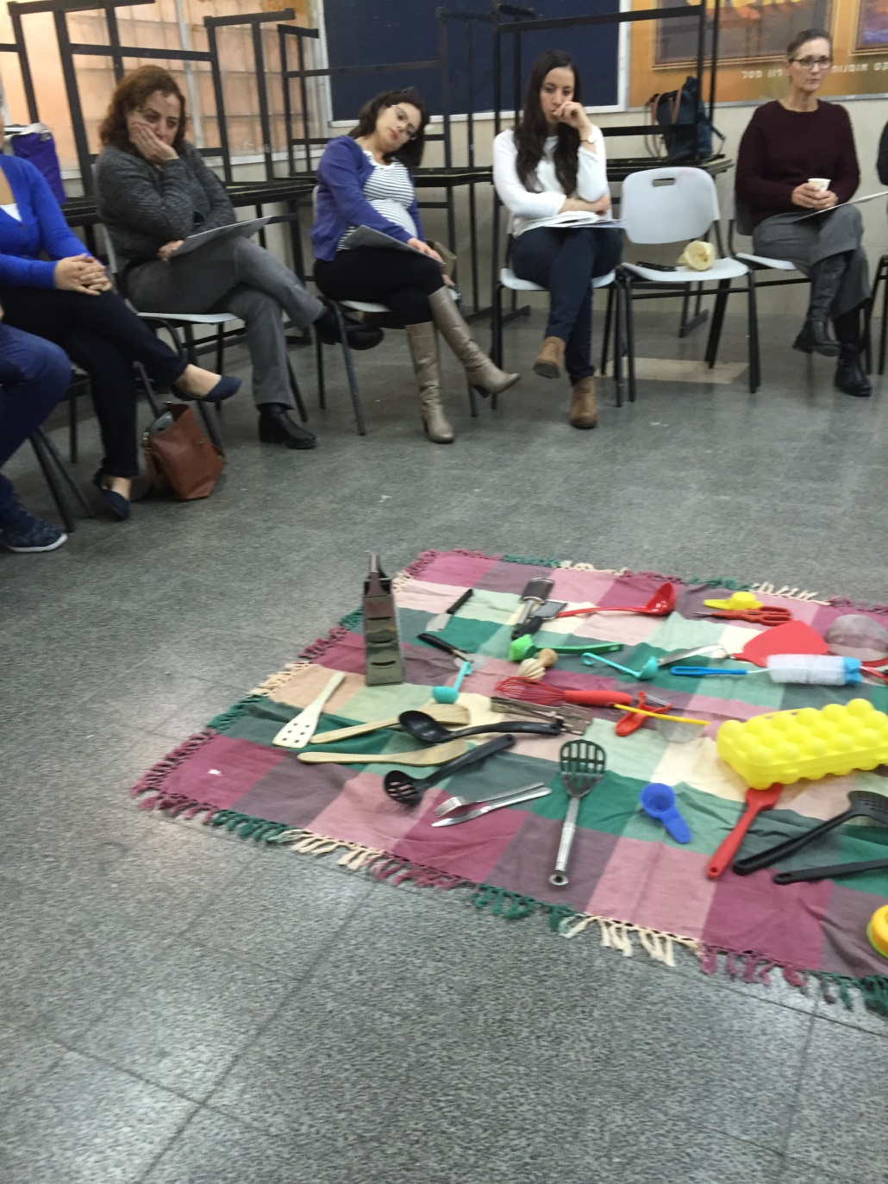
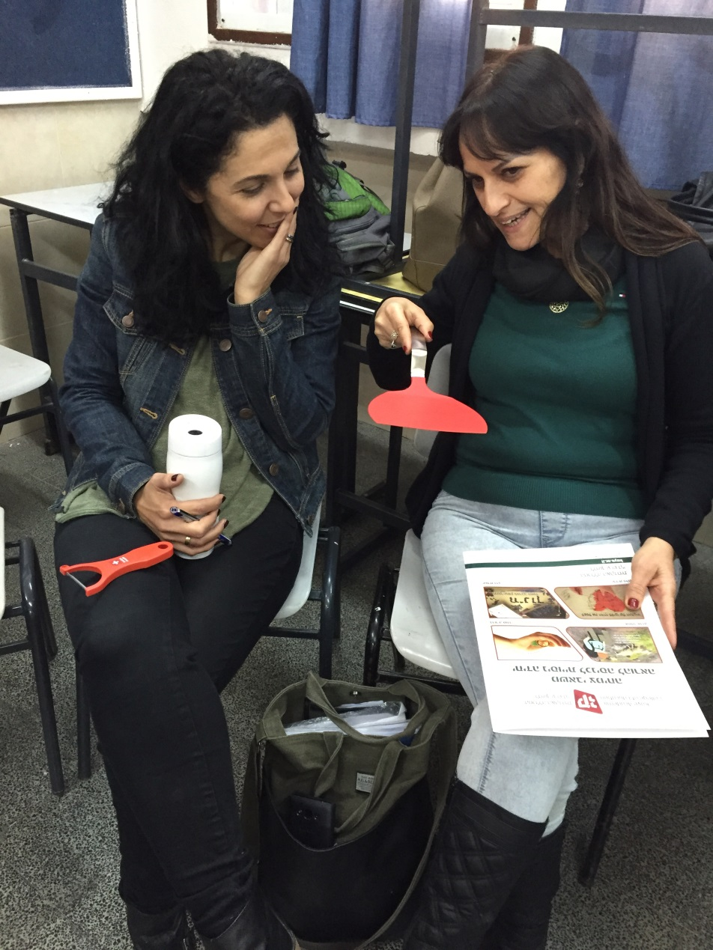

Slide 29
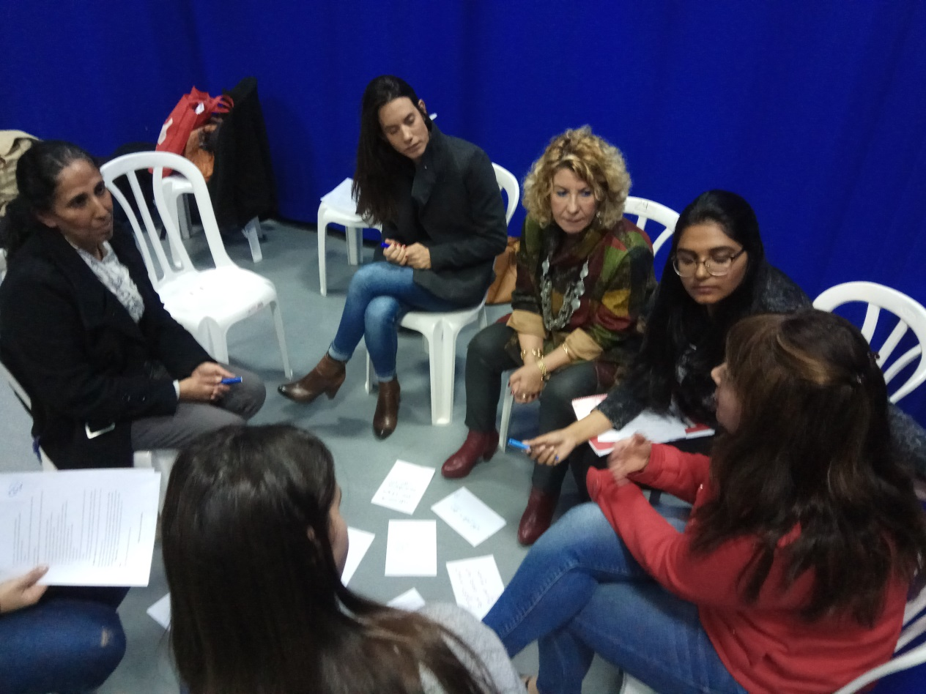
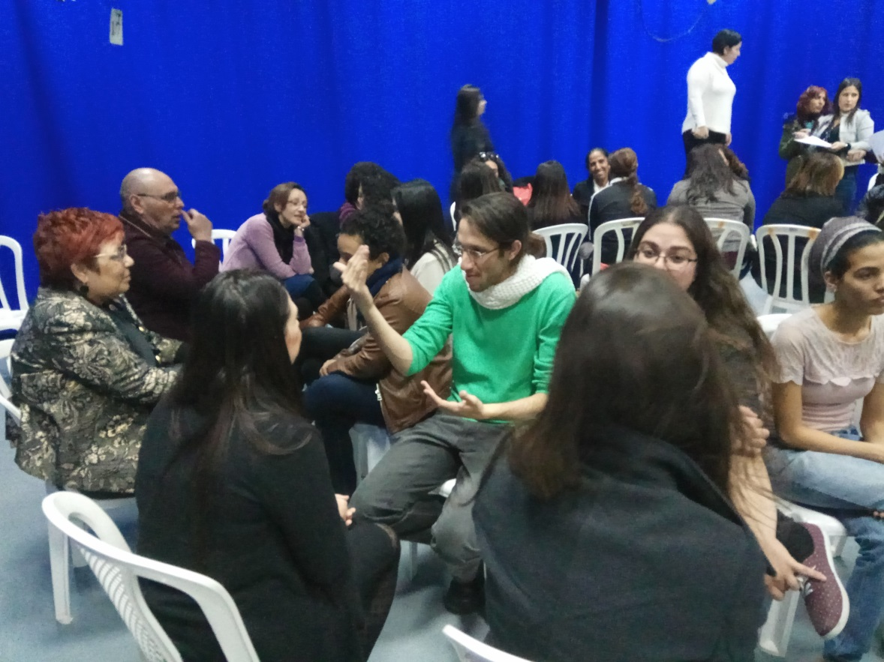

Slide 30
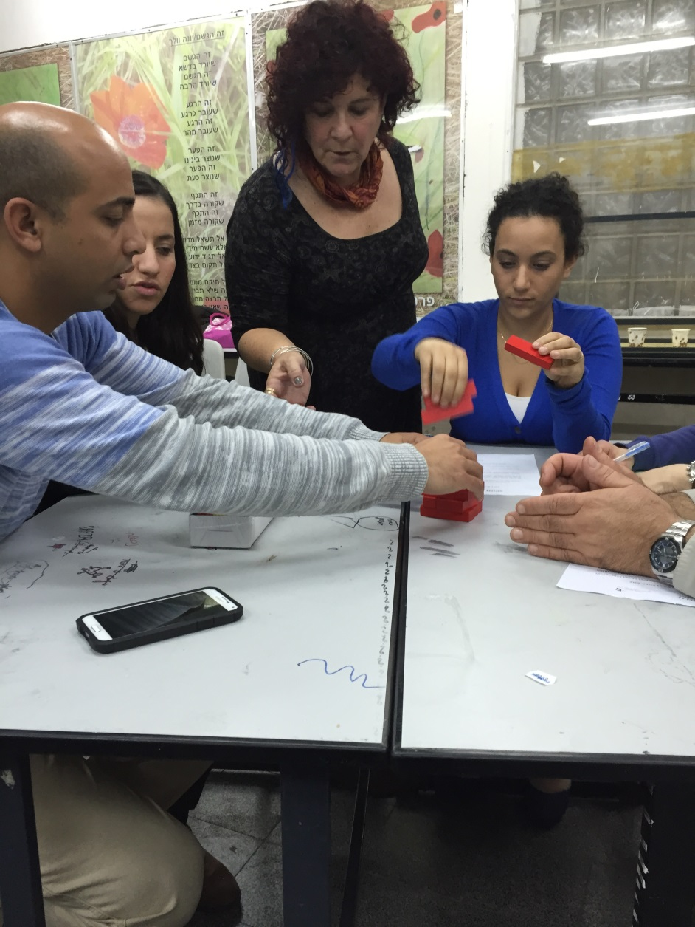
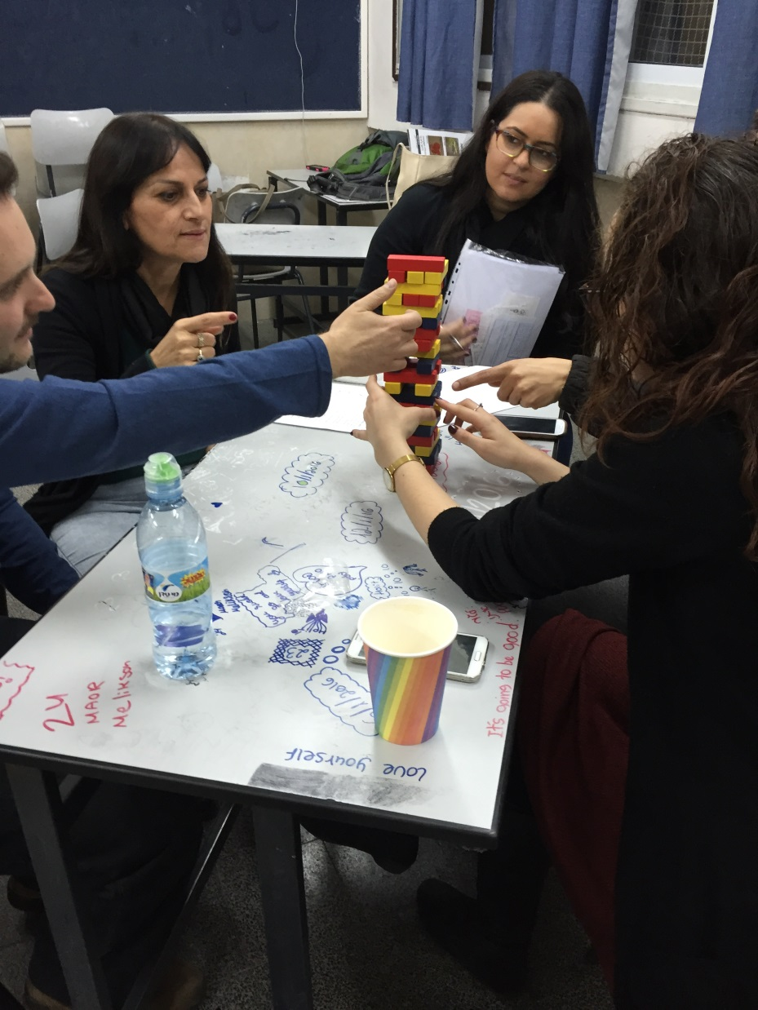

Slide 31
