Slide 1
Mekif Vav
Comprehensive School
Beer Sheva
Growth Resources
Kaye Experimental Induction Unit
In collaboration with the Division for R&D, Experimental Schools and Initiatives
Ministry of Education
Growth Resources – PROTEACH
2016/2017
Norit Avasker

Slide 2
Erasmus+ Project – 2016-2017
PROTEACH – Promoting Teachers’ Success in Their Induction Period
Mekif Vav-Kohl
Beer Sheva
Mekif Vav Comprehensive High School, Beer Sheva Incubator

Slide 3
The Leadership Team 2017
Mekif Vav
Mati Mindlin, Principal
Dorit Schwartzberg, School Counsellor
Keren Turner, Incubator Coordinator
David Greenberg, Pedagogical Coordinator
Kaye College
Dr. Haya Kaplan, Head of the Unit
Rachel Tzafrir, Incubator Coordinator
Dafna Govrin, MIT Group moderator
Dr. Shulamit Fisher, Evaluation Coordinator
Vardit Israel, Mentoring Coordinator
Dr. Mark Applebaum, Head of the Research Authority
Erasmus+ Project
PROTEACH – Promoting Teachers’ Success in Their Induction Period

Slide 4
The Incubator community in 2017
The community of the incubator includes 13 teacher interns and 4 beginning teachers, who are joined by 17 teacher-mentors, teachers from the school, and the college staff.
The incubator in Mekif Vav is part of a locality-based incubator in Beer Sheva.
Partners in the program also include officeholders at policymaking level in the Ministry of Education and local authority.
Together the group forms a unique team, called MIT, that leads to the optimal integration of beginning teachers in the school and the education system.
Erasmus+ Project
PROTEACH – Promoting Teachers’ Success in Their Induction Period

Slide 5
Introductory Meeting Led by the Interns and Novice Teachers
Dialogue on Professional Identity and Personal Values
Meeting date: 24.1.2017
Participants: 17 interns and novice teachers, 17 mentors, school principal, general managerial staff, officers, and college staff.
Invited but unable to attend school inspector, acting officer in charge of education in Beer .Sheva Municipality
Nature of the meeting: Planned workshop based on an open dialogue.
Led by: 17 interns and novice teachers.
Subjects and content:
The present meeting was planned as a festive one with the entire MIT group in order to mark the official launching of the project. Identifying values at the basis of constructing the self.
"The Crystal Ball – My Professional Identity, My Core Values" (see syllabus). The aim of the preliminary meeting was to allow the participants to experience a process that they would themselves moderate.
Subjects for conversation selected by the group:
What did I bring with me that helped me be the teacher I am?
One value that guides me in wearing my professional hat.
A value that has become meaningful for me over the years, a value that has changed. What caused this?

Slide 6
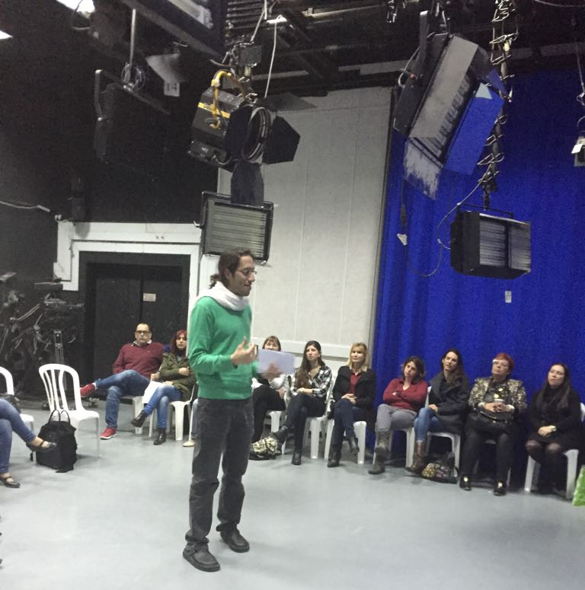
Stage One – Introduction
Getting to know each other –
"Circle of Surprises".
Aim: creation of a pleasant atmosphere, initial steps in getting to know each other, humour arousal. Activity allowing a transition from the intensive work day to the here and now (Focusing activity).

Slide 7
Stage Two: Dialogue according to the “Shavshevet” method. (weather vane)
Division of the group into two circles, an inner one and an outer one: the inner circle is fixed and sitting in it are the interns and novice teachers; the outer circle includes the veteran teachers (school principal, school counsellor, managerial staff, mentors, officers). Each of the participants in the outer circle moves one chair to the right after each dialogue.
The participants are seated facing each other. The time allotted to a dialogue in pairs is 5 minutes, each of the participants receiving 2.5 minutes. Every 5 minutes the topic is changed.
How was room given to the beginning teachers’ voice?
The interns and novice teachers chose the questions and the topics, and volunteered to moderate the various steps.

Slide 8
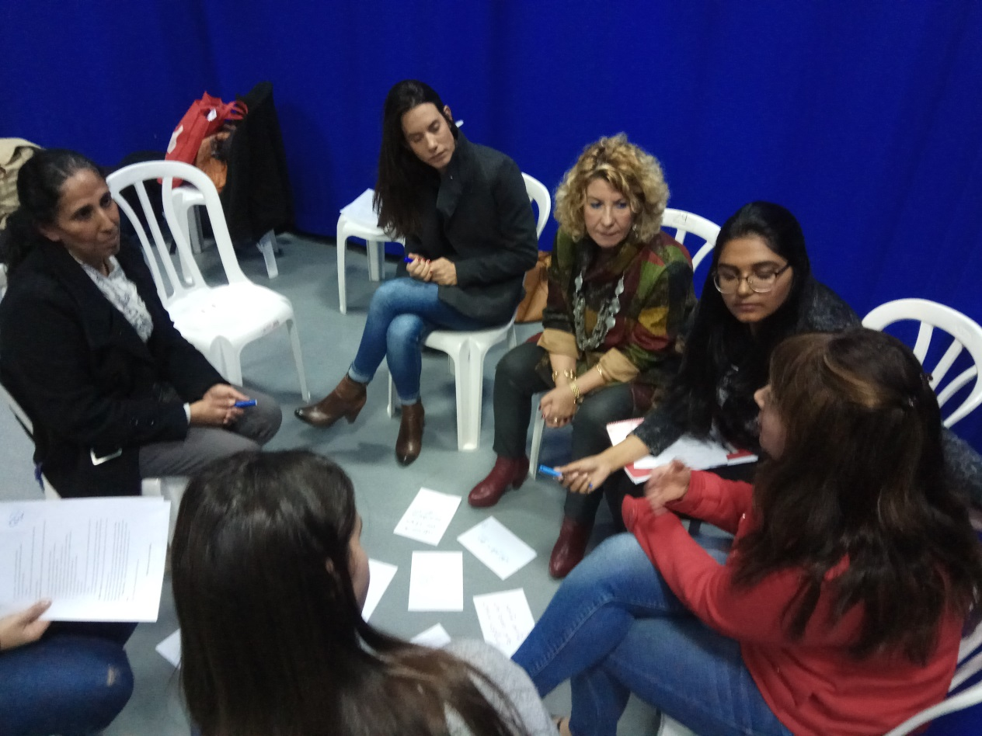
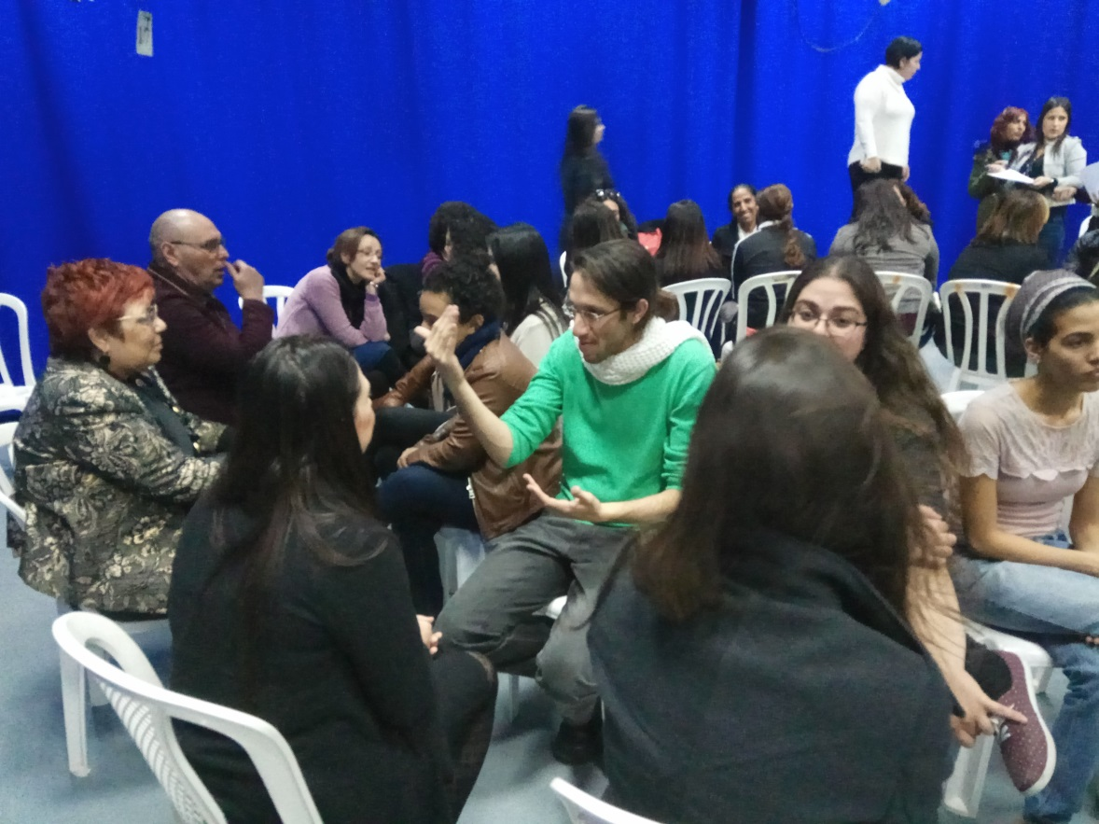

Slide 9
From our experience with the Mit model, the following was learned
Using the model, it is important to build from the beginning a leading team that will meet regularly (school counsellor, incubator coordinator from the school, staff from Keye Collage, incubator coordinator from Keye Collage, MIT group moderator).
The model transfers considerable responsibility to the school staff. It requires the development of trust, development of joint work methods, and is providing great deal of autonomy to the school.
This model requires the college to transfer responsibility to the school.
This model demands flexibility and attention to needs, both on the part of the interns and the school staff. The model requires team work and compromising.

Slide 10
It is necessary to adjust to school culture, to be familiar with the centers of power in the organization, procedures, regularities (who makes decisions).
Following the partnership with the school and listening to the voice of interns, counselor and coordinator, the contents were adjusted according to the needs of all partners.
We learned that the school principal is a key figure. It is important to have fixed meetings scheduled with her , in order to consult with her and get her feedback.

Slide 11
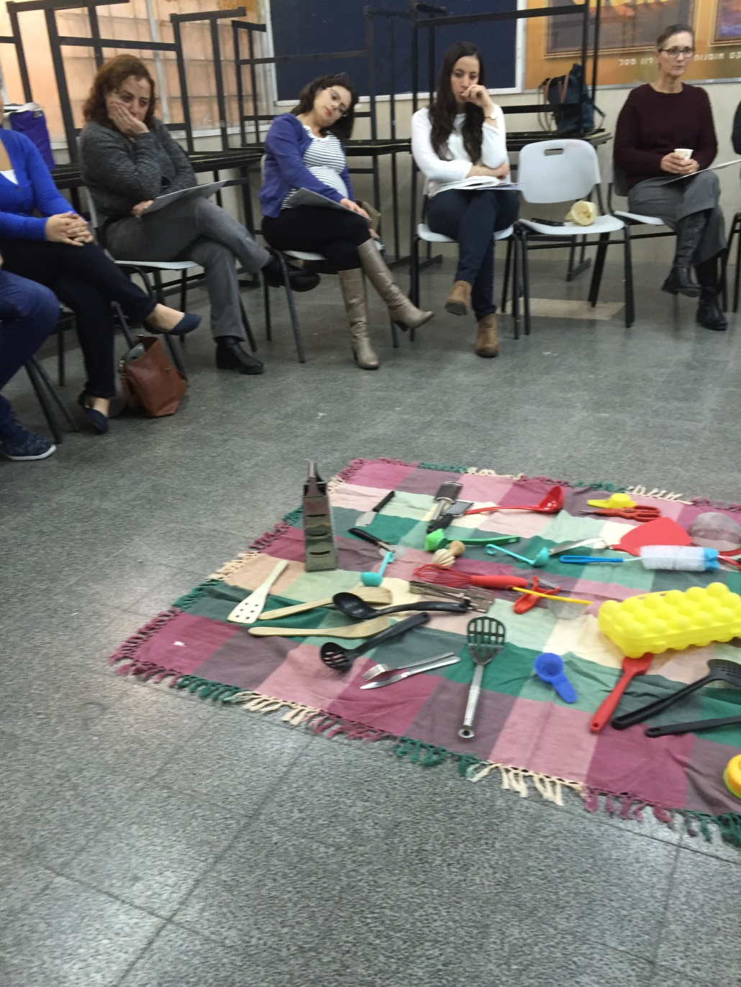
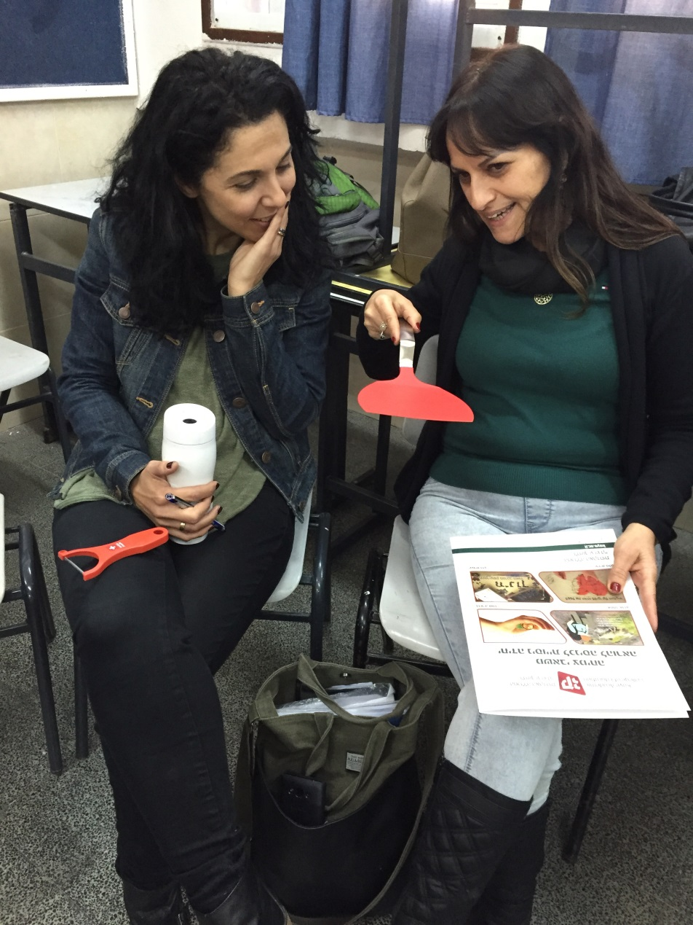

Slide 12
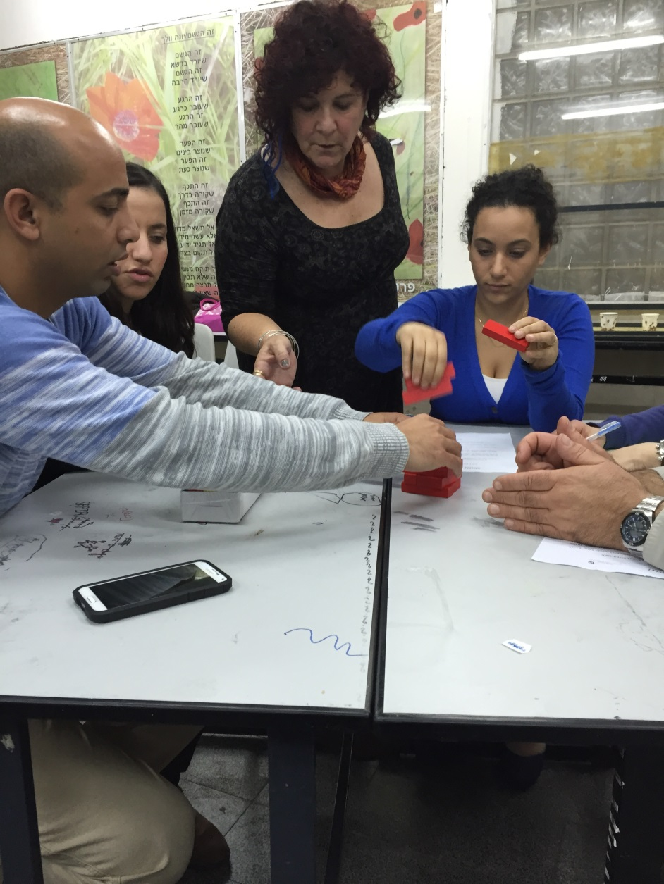
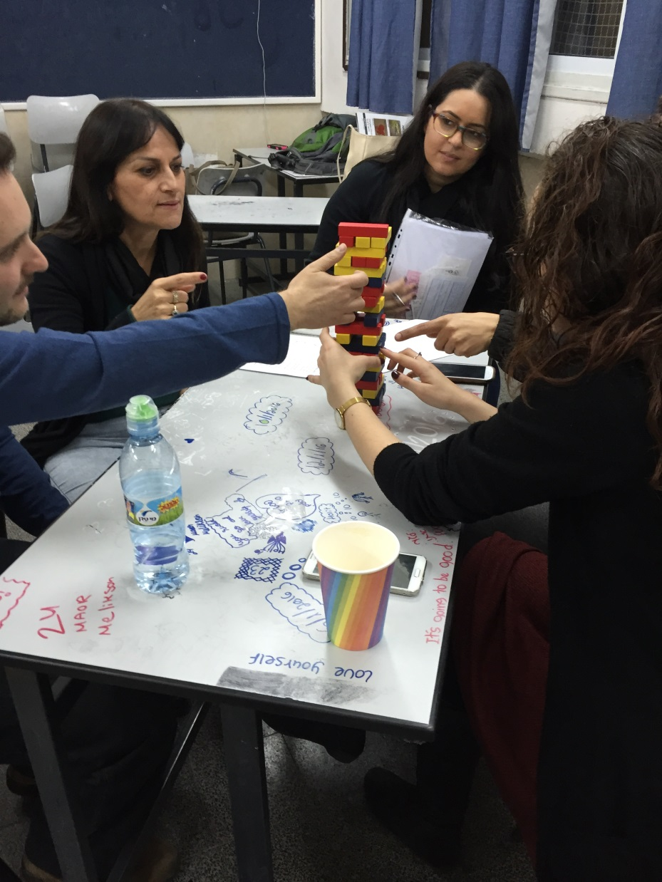

Slide 13
