Slide 1
Preparing for MITs
Sakhnin, talpiyot and Gordon colleges
Presenter- Malka Zinker, Gordon College

Slide 2
Each college has different target audience:
◄ Talpiyot has mostly Jewish religious students
◄ Sakhnin has Arab students
◄Gordon has Jewish ,Druze and Arab students

Slide 3
Each college has a professional experience in induction and mentoring new teachers

Slide 4
Joining the MIT on October 2016
In terms of the MIT, the 3 colleges joined the project and learnt about the MIT for the first time only this academic year.
Therefore, 2 main processes were conducted this year in each and every new participating college:

Slide 5
A-External Process
The learning process of the MIT through participating in monthly meetings in the MOFET institution with the heads of the project and the veteran colleges, through participating in consortiums and learning from the veteran colleges experience.

Slide 6
B- Internal Process
Starting out organizational processes that will allow us to begin the operation of MIT:

Slide 7
1. Executive steps such as presenting the project to the board of management of the college and to potential partners in the college such as instructors, head of unit and faculty members.

Slide 8
2.Choosing the members who will take an official role in the project
( coordinator, moderators and instructors of the MIT)

Slide 9
3.Recruiting schools- involved meetings with key players from the ministry, municipality and the schools.

Slide 10
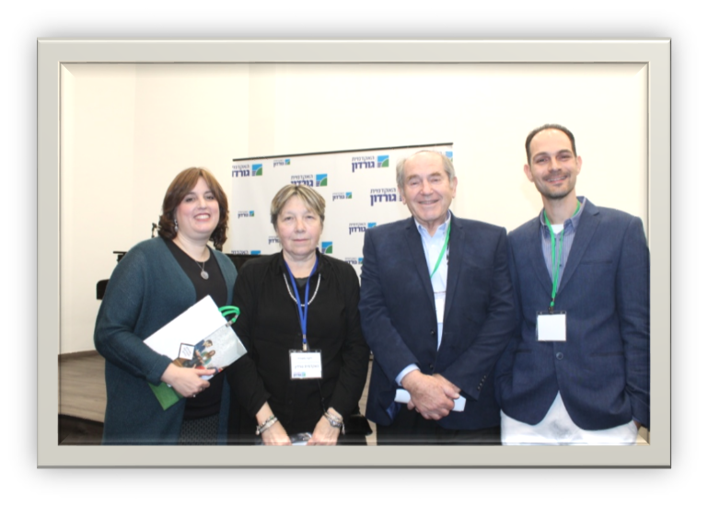
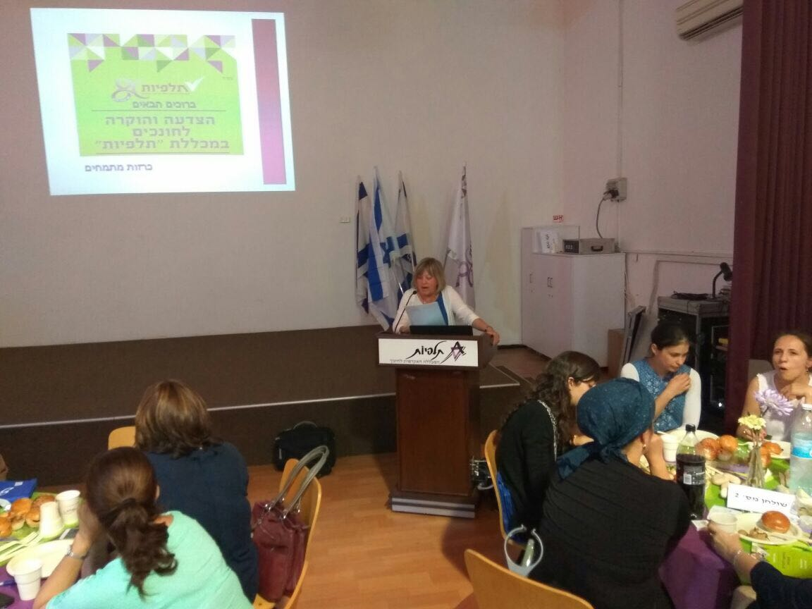
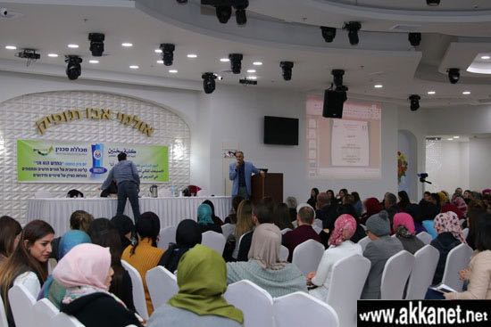
4. Dissemination of MIT in the college in conferences for different kinds of audiences.

Slide 11
5. Preparing for next year's academic course that will accompany the project in the college.

Slide 12
6. Reassuring financial fund resources

Slide 13
7. Starting the process of consolidating the MIT's syllabus together with MIT partners in the college and selected schools for the project.

Slide 14
◄As you can see this is a long and intense process. We are still in the process of learning.
◄ It is not obvious that within less than a year each of the 3 learning colleges has reached the stage where it can operate MIT for the first time

