Slide 1





Deliverable 1.3.1
Training Units for Teachers and Mentors
To sculpt the way to the heart
of the student
Advanced Draft for Discussion
Bucharest PMB / 6-8 March 2017
Lead Organisation – P4
Kaye Academic College of Education
Dr. Kaplan Haya and Rachel Zafrir
Idit Falach – Special Education Program

Slide 2
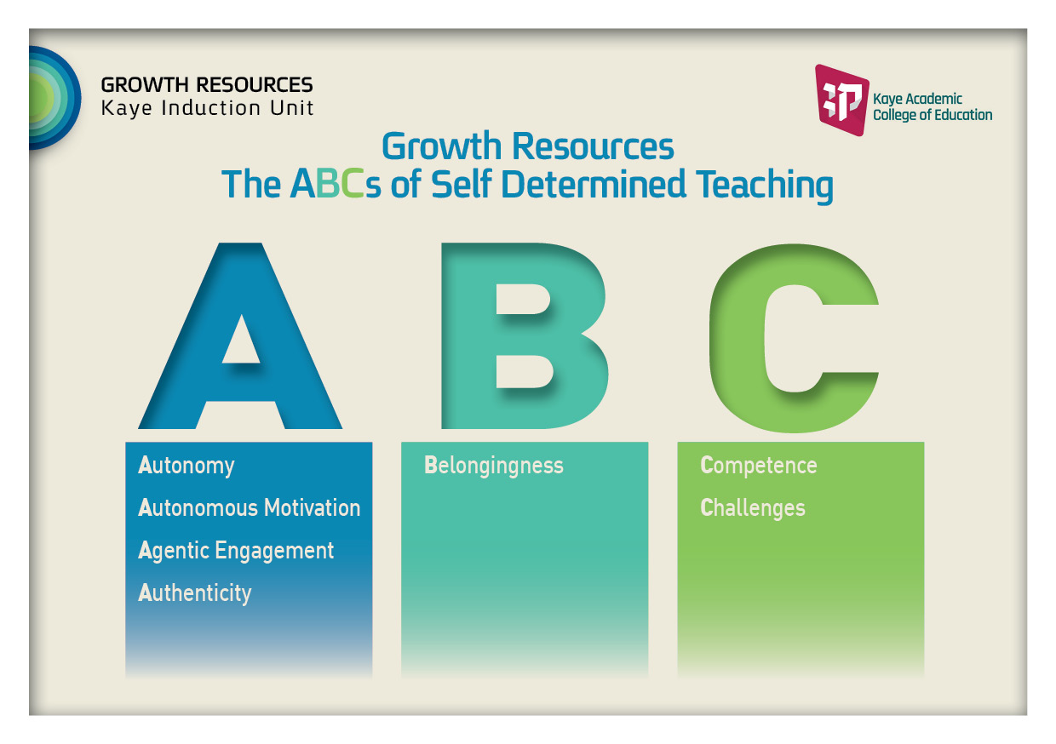

Slide 3
Outline of this deliverable:
Section A: Foundations for the Pedagogical Programme: the project’s rationale, innovations, aims, and objectives.
Section B: Guiding Theoretical Foundation and Educational Approach: relevant theories and approaches, and characteristics of the teachers we seek to promote.
Section C: Description of the Programme; Structural aspects: partners, composition of the MIT groups, role definitions, components of MIT meetings.
Section D: Pedagogical Programme: Main principles, syllabus structure, principles and content.

Slide 4
Theoretical Foundation and Educational Approach

Slide 5
From the formal document (p. 74):
“The model will strengthen beginning teachers’ self-efficacy and voice by involving them as active, self-determining players in the induction process, and highlighting their potential contribution to their schools in terms of unique experience, skills, and expertise”.

Slide 6
Theoretical frameworks:
Self-Determination Theory (SDT; Deci & Ryan, 2000; 2017) .
Role identity construction and exploration processes (Kaplan A., 2014, 2016;
Kaplan H., Glassner, & Ades, 2016).
Agentic engagement (Reeve, 2016).
Positioning Theory (Pinnegar & Shaun, 2011).
Moral issues that influence teachers’ professional identity – need to be developed and written (such as the VaKE model, P11, and work done by P3 and P10).
Training Units for Mentors – theoretical background might be added (P4, P7).
Additional - ?

Slide 7
Self-Determination Theory – SDT
Most induction programmers tend to consider novice teachers as helpless and passive, and most studies focus on teachers’ difficulties (Ulvik & Langørgen, 2012).
SDT specifies the conditions for human growth.
SDT is a humanistic approach that is based on the assumption that people have evolved tendencies toward psychological growth, mastering challenges, and integrating new experiences into a coherent sense of self (Deci & Ryan, 2000).
The social context can either support or thwart these natural tendencies.

Slide 8
Basic Psychological Needs
According to SDT the nutriments for optimal development are three basic innate and universal psychological needs:
The need for relatedness/security
The need for competence
The need for autonomy
Need satisfaction contributes to optimal development and a high level of self-determination: autonomous motivation, well-being, meaningful involvement in practice, social adjustment, and positive functioning (Deci & Ryan, 2000; Roth et al., 2007; Kaplan & Assor, 2012).

Slide 9
Basic Psychological Needs
The need for relatedness
The need to develop a caring, safe, and self-sufficient relationship with close people. Feeling cared for, connected to, and a sense of belonging with others, to be part of a community.
The need for competence
To feel able to fulfill positive expected outcomes (challenging plans and objectives) that are not within easy reach, and to avoid negative outcomes, a desire to feel effective.
The need for autonomy
To act as a causal agent, an urge for volition, self-expression, and meaningfulness. The striving to avoid coercion and have optional choice and voice.
The striving to realize and to form – in an active and explorative way – authentic, direction-giving values, inner tendencies and abilities, goals and interests.

Slide 10
Self-Determination Continuum
Controlled Motivation
Autonomous Motivation
Low level of self- determination
Feeling controlled and suppressed
High level of self- determination
Feeling
self-determined, interested, and joyful
Self-Determination Theory suggests that motivated behaviours vary in the degree to which they are autonomous vs. controlled.

Slide 11
Non-Self-Determined
Self-Determined
A-Motivation
Extrinsic Motivation
Internalisation Process
Intrinsic Motivation
Low perceived
competence
Non-relevance
Non-intentionality
Interest
Enjoyment
External Motivation
Introjected Motivation
Identified Motivation
Integrated
Motivation
Non-
Regulation
Impersonal
External Regulation
Integrated Regulation
Intrinsic Regulation
Inherent Satisfaction
The self-determination continuum, showing the motivational and self-regulatory bases of behaviours that vary in the degree to which they are self-determined (Deci & Ryan, 2000).

Slide 12
SDT Continuum: Types of perceived motivations
(Sources or reasons for intentional action)
Controlled motivation:
External Motivation: Behaviour is controlled by external contingencies (punishments, threats, hope for material rewards).
Introjected motivation: Behaviour is controlled by the desire to avoid feeling guilty, ashamed, unworthy or rejected, as well as the desire to gain highly positive evaluations (self- and others’ evaluations).
Autonomous motivation:
Identified Motivation: Behaviour is considered autonomous. The person has accepted the value of the activity as his own. Identifying with the importance or value of the behaviour.
Integrated Motivation: Assimilating the identifications with other aspects of the person’s self. The activity/value is perceived by the individual as being congruent with his identity.
Intrinsic Motivation: Purely intrinsic motives involve engagement in an activity for its own sake (spontaneity, excitement, joy).

Slide 13
SDT Perspective
Need-Supportive Environment
Need-Supportive
Environment
Teachers’ Need Satisfaction
Teachers’ Outcomes
Autonomous motivation in teaching
Enhanced internalisation
processes (identification with the teaching profession)
Sense of self-actualisation
Wellbeing, positive emotionality, and satisfaction
Active agentic engagement
Relatedness Support
Sense of Security and Relatedness
Autonomy Support
Sense of Competence
Competence Support

Slide 14
Autonomous motivation in teaching
The teacher experiences deep satisfaction and interest in his/her work as a teacher (intrinsic motivation). He/she identifies with the teaching profession, its values and demands, and sees the connection between teaching and his/her personal values, aims, needs, and abilities.
Teaching is part of the teacher’s identity and he/she experiences a sense of choice, volition, self-fulfilment, and meaning (identified and integrated motivation).
I act out of an awareness of the importance of teaching and/or because of interest, free choice, and need for self-actualisation.

Slide 15
What are the teacher’s characteristics we are seeking to promote?
Self-determination and agentic engagement – build for yourself an environment that supports your needs!
Autonomous motivation for teaching, a sense of competence, and a sense of relatedness to a group and the school.
To be active, involved, to share experiences, and be open to learn from others.
To be proactive, to propose and implement initiatives for the benefit of teaching and the school.
Setting strength-based growth challenges and positive thinking, as opposed to focusing on problems.
Inclination and ability for exploration: What will enable me to grow as a teacher? What are my inner strengths and resources? What are my values? What are the resources in the environment?

Slide 16
Promoting Teachers’ Exploration process toward Role Identity Formation
The “Dynamic Role Identity Model”
(A. Kaplan, 2014; A. Kaplan & Garner, 2016)

Slide 17
Identity Formation and Exploration
The concept of “identity formation” is of key importance in the process of teachers’ professional development. One of the significant components of the identity formation process is identity exploration (e.g., Grotevant, 1987; Marcia, 1993).
The term “exploration” refers to a process and the actions deriving from it which are guided by the individual him/herself, or by means of external support in which the individual is involved in a reflective search for and inquiry of information about him/herself or about the external world that is important for his/her development.
The explorative process enables the individual to create meaning and advance his/her identity formation process.

Slide 18
The “Dynamic Role Identity Model” highlights the role of the teacher as a proactive, intentional and reflective agent that is oriented towards development (kaplan, 2014).
The model comprises four dynamic interconnected context-specific components that together comprise the teacher’s professional identity, with reference to the teacher’s role:
Ontological and epistemological beliefs.
Purpose and goals of education and teaching.
Self-perceptions and self-definitions, values.
Teacher-perceived action possibilities.

Slide 19
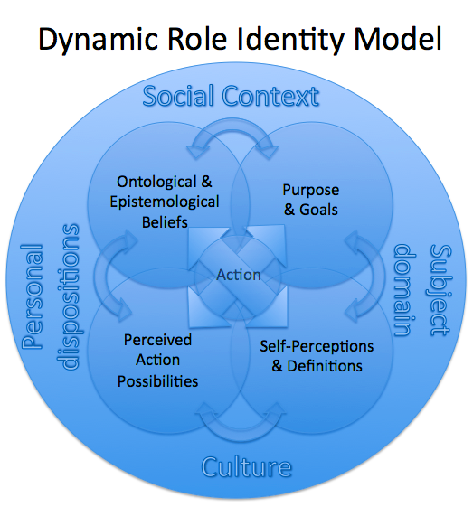
(Kaplan, 2014; Kaplan & Garner, 2016)

Slide 20
Ontological and epistemological beliefs
The teacher’s knowledge of and beliefs concerning the “nature of the world” with reference to teaching and learning, the nature of educational processes, knowledge creation, student characteristics and more.
Teachers’ beliefs also refer to school reality: How the teacher perceives the school, the entities operating within it, the demands placed on him/her, and so forth.
Purpose and goals of education and teaching
Teachers’ definition concerning the purpose of education and teaching, the goals the teachers want their students to achieve, and the goals they set for themselves in teaching.

Slide 21
Teachers’ self-perceptions and values
Teachers’ self-definitions, the values they formulate for themselves, their beliefs concerning themselves, perceived need satisfaction (competence, relatedness, and autonomy), self-perceived traits, and more.
Teacher-perceived action possibilities
Actions and behaviours teachers perceive as relevant and appropriate in order to achieve their personal and teaching goals in light of their beliefs concerning learning, knowledge, teaching, and the school reality in light of their self-perceptions.

Slide 22
Principals for promoting adaptive Identity exploration
Supporting exploration processes is achieved by supporting teacher’s psychological needs (Deci & Ryan, 2000):
Supporting and promoting self-relevance as part of supporting autonomy.
Supporting relatedness in order to create a safe environment and dialogue – facilitating sense of safety and avoiding inner threats.
Triggering identity exploration (a dilemma or a subjective experiences of discrepancy from current identifications, such as goals, values, self perceptions, social roles)
Supporting competence by providing scaffolding for this process.

Slide 23
Positioning Theory

Slide 24
Positioning processes are founded on Positioning Theory (Pinnegar & Murphy, 2011), which addresses how the individual subjectively perceives his/her interrelations with others.
The approach refers to the fact that “speakers bring to their interactions different claims or rights to speak, and they perform different duties and have different responsibilities and obligations that reflect differences in the distribution of power and authority” (Bullough & Draper, 2004, p. 408).
The approach contributes to an examination of the evolving and developing relationships over time by people involved in social interrelations in the educational system.

Slide 25
According to this approach, the interactions and relationships between the participants in the system are determined according to how one positions him/herself and is positioned by others within the educational system.
Thus, the way individuals position themselves or others affect their and others’ self-perceptions and behaviours.
Positioning Theory can constitute an analytical schema to understand how educators and teachers perceive their roles and responsibilities, how they understand what is required to be a “good teacher” and the ways they integrate into the teaching profession.

Slide 26
Agentic Engagement
To be agentically engaged is to intentionally influence
one’s functioning and life circumstances
(Bandora, 2006; Reeve, 2015)

Slide 27
To create for yourself needs supportive environment
An “agent” is someone who influences intentionally his/her functioning and life circumstances (Bandora, 2006).
Agentic engagement is a proactive pathway to positive functioning and outcomes or gains that might be personal, environmental or relational.
The term “agentic engagement” originally refers to students and their relationships with their teachers. According to Reeve, agentic engagement refers to students’ constructive contribution to the flow of the instruction they receive (Reeve & Tseng , 2011).
In order to be agentically engaged students need to offer inputs, express preferences, offer suggestions or a contribution, ask questions, communicate what they think and need, recommend a goal to be pursued, communicate their level of interest, seek ways to add personal relevance, generate options, communicate likes and dislikes.

Slide 28
What I want and What I need as a beginning teacher..
With regard to beginning teachers we refer to the process in which teachers intentionally and proactively try to personalise and enrich both what is learned, discussed, and done in the group and the ways they try to build for themselves a group and a school environment that support their psychological needs.
The teachers become proactive while trying to express their preferences and to improve the conditions and circumstances of their work environment.
To the extent to which teachers act agentically, they initiate a process in which they generate for themselves a wide array of options that utilise their freedom of action and increase their chances of experiencing both autonomous motivation (e.g., need satisfaction, autonomy, self-efficacy) and meaningful and relevant learning as beginning teachers.

Slide 29
From Approach to Practice / Organising Foundations
Supporting teachers’ psychological needs – competence, relatedness, and autonomy – might create core practices that constitute an organising foundation for the group meetings and for the systemic work at the school.
SDT is a humanistic approach to human nature. It essentially views the individual as autonomous and self-determined that might agentically lead his/her professional development and identity construction.
SDT provides a rationale for why we want to place the teachers’ voice at the centre and promote their competence, enable them to be active and proactive, to place their abilities, experiences, and fields of interest at the centre, and encourage them to initiate and contribute to the school and for themselves.

Slide 30
SDT Core Practices
Need-Supportive Environment
Relatedness Support
The group as a safe place for all the participants. Creating guidelines for care-full conversations (dialogue).
Tuning in transition from the outside to the inside.
Using non-judgmental language.
Creating a caring community among the teachers themselves and among the group facilitator and the teachers.
Enhancing familiarity among group members.
Respect for culture, variety as a source for growth.
Reflective and emotional dialogue, sharing of teaching experiences.
Legitimisation for airing difficulties or ‘mistakes’, difficulties as growth-challenging.

Slide 31
Need-Supportive Environment
Competence Support
Enabling the teachers to choose optimal challenging goals.
Encouraging giving and receiving non-evaluative feedback (by the group facilitator and the group members).
Need-promoting dialogue and communication skills.
Enhancing positive thinking, identification of strengths in oneself.
Discussing relevant issues (e.g., class management, and handing discipline in an autonomy-supportive way).
Discussing effective time management and coping strategies.
Giving positive messages regarding the teacher’s ability to be proactive and manage his/her professional life.
Enhancing self-evaluation in the framework of the internship evaluation processes.
Encouraging self-representation (self-advocacy).

Slide 32
Need-Supportive Environment
Autonomy Support
Discussion of authentic-relevant cases.
Enabling choices and decision-making regarding the group work.
Encouraging exploration processes regarding one’s professional identity (values, tensions, vision).
Supporting examination and construction of values/goals/interests.
Respect for culture. Adaptation of learned skills to the culture.
Accepting and acknowledging the other’s internal frame of reference (e.g., empathy, and perspective taking).
Encouraging self-initiation and proactiveness.
Encouraging expression of independent opinions and criticism.
Encouraging the participants to find their own meaning and ways by themselves and within themselves (without the facilitator’s recipes).
Emphasis on challenges – problems as strength-based growth challenges.
Parallel processes in the workshop and the classroom/school – supporting relevancy.
Identifying personal strengths and resources, discussing cases demonstrating learning from successes.

Slide 33
From Approach to Practice / Organising Foundations
The “Dynamic Role Identity Model” provides an additional organising foundation for a dialogue that will help beginning teachers in the process of constructing their professional identity and their role as a teacher. Thus, in every dialogue it is important to observe and refer to the dialogue components proposed by A. Kaplan (2014). This model can serve as a framework for case study analysis.
Positioning Theory connects with Kaplan’s exploration model. Thus, the exploration process can help teachers examine their self-perceptions concerning their positioning in the school and their relationships with various figures.
This theory is also congruent with SDT since positioning perceptions are an expression of teachers’ autonomy (or alternatively of an experience of autonomy suppression). The emphasis on relationships is central in SDT as well.

Slide 34

If you want to build a ship, don’t drum up people to collect wood and don’t assign them tasks and work, but rather teach them to long for the endless immensity of the sea.
Antoine de Saint Exupery

Slide 35
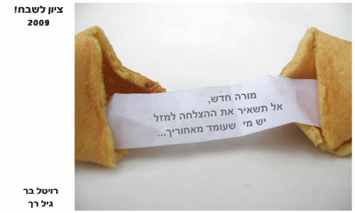
Revital Bar
Beginning teacher – don't leave the success to luck… there is someone behind you

Slide 36
Some references
Bullough, R. V., & Draper, R. J. (2004). Making sense of a failed triad: Mentors, university supervisors and positioning theory. Journal of Teacher Education, 55(5), 407-420.
Deci, E. L., & Ryan, R. M. (2000). The “what” and “why” of goal pursuits: Human needs and the self-determination of behavior. Psychological Inquiry, 11(4), 227-268.
Kaplan, H., & Assor, A. (2012). Enhancing autonomy-supportive I–Thou dialogue in schools: Conceptualization and socio-emotional effects of an intervention program. Social Psychology of Education, doi:10.1007/s11218-012-9178-2.
Kaplan, A. (2014). Professional teachers’ role‐identity: A framework for promoting, and measuring a crucial aspect of teachers’ professional development. Temple University.
Pinnegar, S., & Murphy, M. S. (2011): Teacher educator identity emerging within a teacher educator collective. Studying Teacher Education: A journal of self-study of teacher education practices, 7(2), 211-213.
Reeve, J. (2013). How students create motivationally supportive learning environments for themselves: The concept of Agentic Engagement. Journal of Educational Psychology, Apr 29 , 2013.
Reeve, J., & Assor, A. (2011). Do social institutions necessarily suppress individuals’ need for autonomy? The possibility of schools as autonomy promoting contexts across the globe. In V. Chirkov, R. M. Ryan, & K. Sheldon (Eds.), Human autonomy in cross-cultural context: Perspectives on the psychology of agency, freedom, and well-being. Springer.
http://www.psych.rochester.edu/SDT/

Slide 37
Group moderators’ and mentors’ need support and teachers’ outcomes
novice teachers (2014)/ Path Analysis
Autonomous Motivation in workshop - T1
Workshop
Group Moderator
.52
Satisfaction T2
15
Satisfaction
T1
Need Support
T2
.85
.27
.38
Group
Moderator
Support - T2
.42
Autonomous Motivation in workshop - T2
.43
Positive Affect
T2
.34
Positive Affect
T1
Exploration
Support
T2
.80
. 22 **
.13*
Teaching / School
.19**
Self-actualisation T2
.30
Self -actualisation T1
Autonomous Motivation at school - T1
.21*
Teacher Mentor
. 13**
Need Support
T2
89
.46
.43
.29
Competence in Teaching T2
.24
Competence in Teaching T1
Teacher Mentor Support - T2
Autonomous Motivation at school - T2
.80
.21 **
Exploration
Support
T2
-.22
.23
Burnout
T2
.22 **
Burnout
T1
Self-Determination Theory, The 6th International Conference
June 2-5, 2016, Victoria, BC, Canada

