Slide 1
PROTEACH PROJECT- GORDON COLLEGE,HAIFA
Presenter: Malka Zinker
Team members: Dr. Liron Onn
Mrs. Sarit Linker
Dr. Rhonda Sofer

Slide 2
NATIONAL CONFERENCE ON THE CHALLENGES OF THE INDUCTION YEAR FOR NEW ISRAELI TEACHERS.
This conference was the first induction conference that has ever been held in Israel.
Papers were presented by experts who have researched this topic..
Proteach Colleagues from GACE, BB, Sak, and KAYE Colleges: Dafna, Haya, Idit, Waleed and Liron all presented at this confernce.

Slide 3
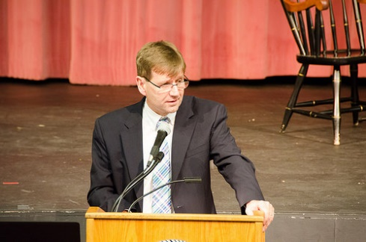
TOPICS OF PRESENTATION
Some of the presentations discussed different support strategies for new teachers.
Incubators or “nests” ( Hamamot) within the schools.
Online workshops
Face to face workshops.
In this conference Mrs. Sara Zilberstrum who is Director of the Induction of New Teachers from the Ministry talked about The MIT project and presented it to the audience.

