Slide 1
Dissemination Activities In GACE
Dr. Liron Onn
Mrs. Malka Zinker

Slide 2
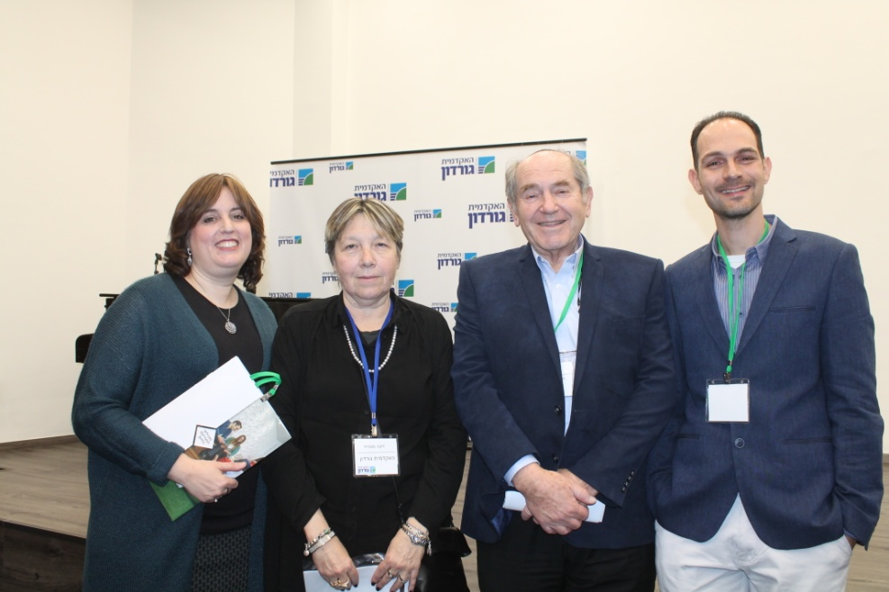
First Event:National Induction Conference 14/2/17
GACE-Gordon Academic College of Education
Dr. Liron Onn
Head of the Induction Unit in GACE
Dr. Sara Zilberstrum
The Head of Induction and
Internship in the Israeli Ministry
of Education
Prof. Ditza Maskit
Prof. Yechezkel Taller
Te President of GACE

Slide 3
Partners responsible or involved
●The Induction Department in Gordon College
●Faculty members
● Heads of Induction departments from many academic institutions for education in Israel
● Inspectors from the ministry and policy makers.

Slide 4
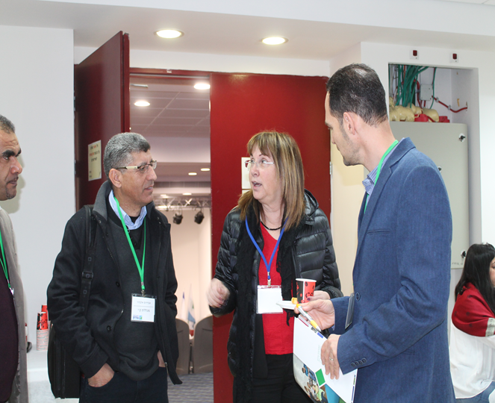
Description of the activity carried out
● 200 people participated in this conference. Among them faculty members of almost all the academic institutions for education in Israel .All Proteach members from Israel had representatives in the conference and all Heads of Induction Departments presented different aspects of research and achievements.
● Special sessions were held for the dissemination of the ERASMUS+ Proteach project within the conference itself. The sessions were held by the Head of Induction departments in Kaye College, Dr. Haya Kaplan and her association members.
● Dr. Sara Zilbershtrum, the Head of Induction and Internship in the Israeli Ministry of Education, reported on the project in the main session of the conference and related to the international cooperation in the Proteach project.

Slide 5
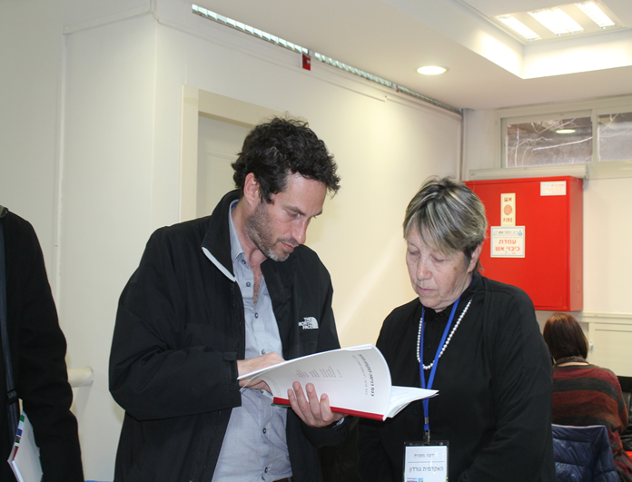
Specific and measurable indicators of achievement
● Getting positive feedback from researchers who participated in the conference.
● Getting support and approval from the inspectors of the ministry in Haifa district.
● It allowed the dissemination of the Proteach project to faculty members from many academic institutions of education in Israel and inspectors from the ministry in the Haifa district.

Slide 6
2nd Event:Mentor Teachers Conference- Evaluation of new teachers 15/5/17
GACE-Gordon Academic College of Education

Slide 7
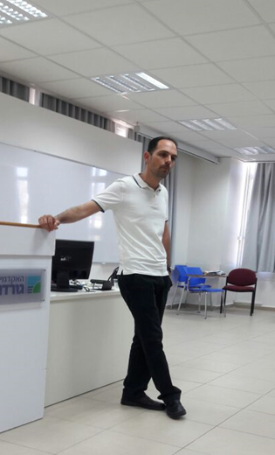
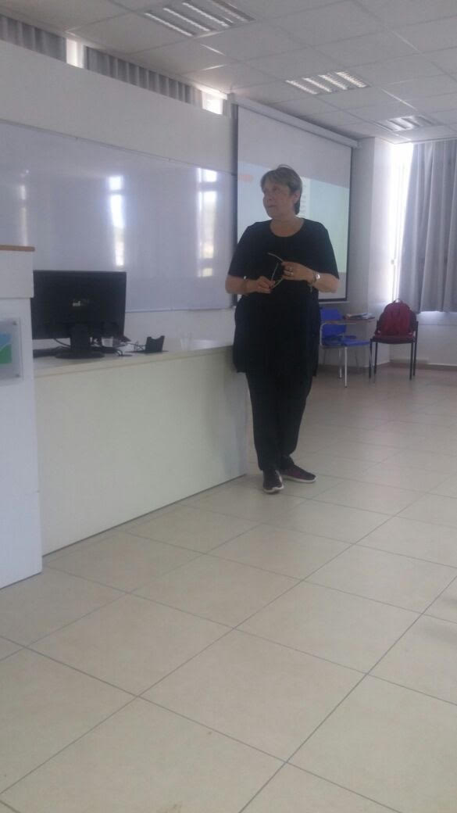
Partners responsible or involved
● The Induction Department in Gordon College
● Faculty members
● Mentor teachers
● Prof. Ditza Maskit and Dr. Ornat Turin

Slide 8
Description of the activity carried out
● Gordon College hosted a Conference for Mentor-Teachers on the Evaluation of New Teachers. The conference was held on May 15, 2017. It was the third meeting of mentor-teachers who are responsible for guiding Gordon's new teachers.
● In this conference, we presented the ERASMUS+ Proteach project to the mentor teachers, faculty members of our department for continuing professional development and teachers from the school which is integrating the MIT during the next year of 2017-18.
● In this conference Prof. Ditza Maskit talked about the challenges of evaluating new teachers within the mentoring processes and Dr. Ornat Turin spoke about mentor-teachers in the movies.

Slide 9
Specific and measurable indicators of achievement
● It allowed the dissemination of Proteach project to the mentor teachers that guide our new teachers and faculty members.
● We got positive feedback from the mentors who wanted to learn more about the project and how they can take part in it.

