Slide 1



SOME SUGGESTED TOOLS for preparing trainees to enter MITs at the HEI level.
Dr Karen Walshe
BRYAN SMITH

Slide 2
AIMS OF THE PROTEACH PROJECT
To improve the quality of teacher training in higher education institutions in Israel through multilateral stakeholder partnerships in the teacher induction process (MITs - Multiplayer Induction Teams)
To amplify beginning teachers’ voices.
To improve retention rates of beginning teachers in the profession, as well as their contribution to and integration into schools.

Slide 3
What tools might help to achieve these aims?
1. Exeter model of Initial Teacher Education
Deliberately scaffolded and phased approach to ITE
2. RETAIN project
EU-funded collaborative research project involving partners from five countries (Denmark, Belgium, Turkey, Spain and the UK).
Overall aim: To help schools to create and develop an inclusive and creative environment to improve the retention of high quality teachers.
Key objective: To develop and trial a set of tools designed to help school managers and teachers to create an inclusive and creative working environment

Slide 4
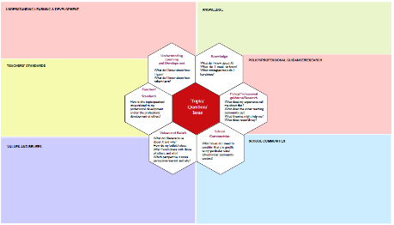
1. Exeter Model of Initial Teacher Education
The Framework for Collaborative Dialogue (or the Framework for Dialogue about Teaching)
Rooted in Activity Theory – supporting teachers in exploring how they can take action for change in relation to a key issue/problem

Slide 5

How do we use the FDT in developing BT/trainee voice at HEI level?
As a tool to structure trainee teachers’ reflections, when planning or evaluating a lesson/unit of work
As a tool to facilitate paired/small group discussion of a key issue
As a tool to scaffold small group discussion of a key issue (individual reflection in advance followed by small group discussion)
As a tool to help trainees to negotiate their way through complex and often conflicting points of view
Ensures that more than one voice is heard
Facilitates exploration of an issue from multiple perspectives
Gives them a model of effective dialogue for use in the BT phase

Slide 6
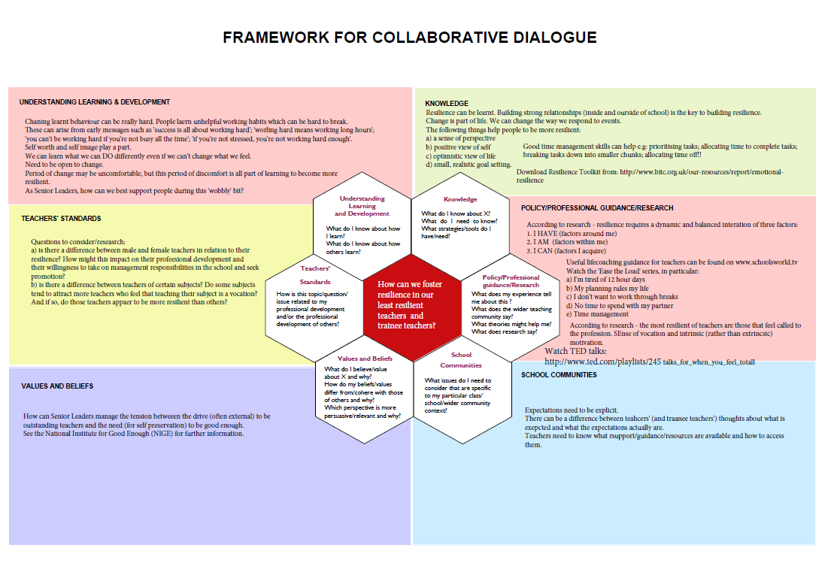

Slide 7

Why is it a useful tool?
Previous research identified the importance of dialogue, in particular, small group dialogue, in teacher education, as it provides a valuable forum within which trainees/teachers can articulate currently held conceptions; engage in critical conversations; and explore unfamiliar, differing and conflicting perspectives (Agee 1998).

Slide 8
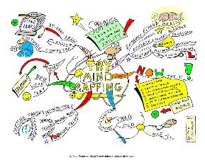
Recent studies have shown that not only is it important for teacher education to provide such opportunities but also to provide a means (such as a framework) by which participants can analyse, synthesise and evaluate ideas in order to begin to construct a coherent theory (see for example Himangshe 2012).

Slide 9
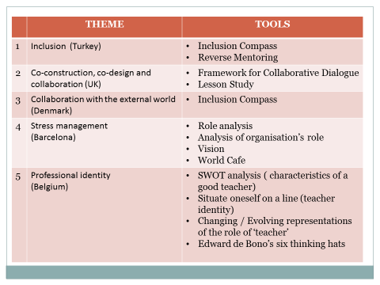
Implementing tools from RETAIN project Toolbox
http://www.retain-project.eu/

Slide 10
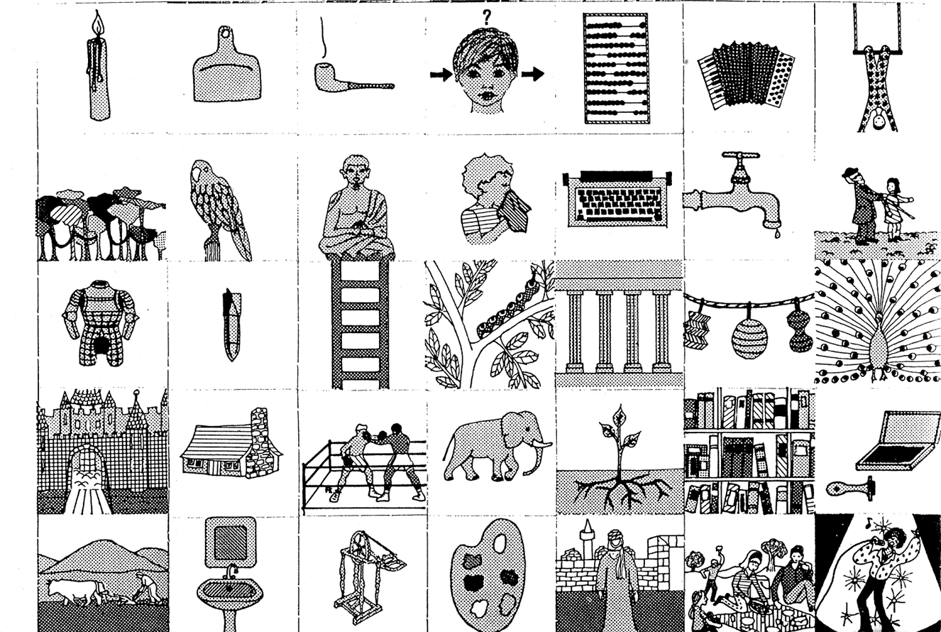
PROFESSIONAL IDENTITY: PICTOGRAMS

Slide 11
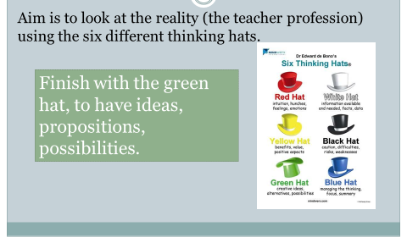
PROFESSIONAL IDENTITY: 6 THINKING HATS

Slide 12
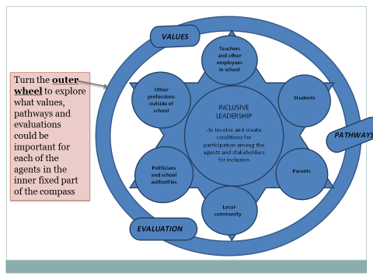
INCLUSION: THE INCLUSION COMPASS

Slide 13
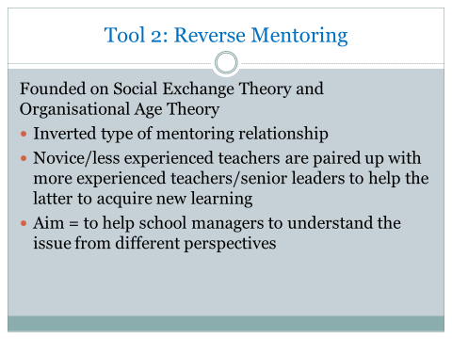
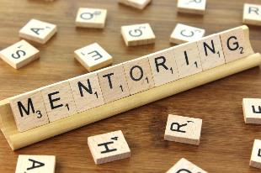
INCLUSION: REVERSE MENTORING

Slide 14
COLLABORATION: LESSON STUDY
Cyclical process involving (usually) a triad of teachers who collaboratively plan a lesson.
Teacher 1 teaches the lesson observed by the others. All three evaluate the lesson and revise it.
Teacher 2 teaches revised lesson observed by the others.
All three evaluate the lesson and revise it.
Teacher 3 teaches revised lesson observed by the other.
All three evaluate the lesson.

Slide 16
Why is it a valuable tool?
Fosters shared ownership of the lesson. Sense of ‘risk’ is shared.
Enables critically reflective evidence based thinking about the impact of the teaching on pupils’ learning.

Slide 17
PROTEACH PROJECT AIMS | TOOLS
To improve the quality of teacher training | Framework for Collaborative Dialogue Lesson Study
To amplify beginning teachers’ voices and their contribution to their school. | Reverse Mentoring Inclusion Compass Framework for Collaborative Dialogue Lesson Study World Café Edward de Bono’s six thinking hats
To improve the integration of beginning teachers into their schools | Inclusion Compass Framework for Collaborative Dialogue Lesson Study Analysis of organisation’s role Vision Role analysis SWOT analysis Situate oneself on a line Changing/evolving representations of the role of the teacher World café Edward de Bono’s six thinking hats
Improve retention rates of beginning teachers

Slide 18
THEORETICLAL FOUNDATIONS
Social constructivist theories of learning (e.g. Vygotsky, 1978)
Schools as communities of practice (see Lave and Wenger, 1991)
Scaffolded progress towards independent practice (e.g. Bruner, 1978)
Activity theory - teachers taking action for change (e.g. Engeström, 1999)
Reflective practice (e.g. Brookfield 1995)

